Slide 1
Travel and ePay User Group Meeting
March 28, 2022

Slide 2
Agenda
Grocery Store Updates
BCD Fee Changes
Southwest Airlines Integration via Sabre
Car Shortages
Updates to UC Preferred Car Rental Agreements
Emirates Ticket Update
Group Bookings with BCD Travel
General Travel Reminders
Donor Cultivation and Recruitment Events
Concur Update
Q&A

Slide 3
Grocery Store PO Updates
March 2022

Slide 4


Grocery Store PO’s
As of March 2022, AP was informed Ralph’s grocery stores have stopped accepting PO’s for business purchases.
The following stores still allow purchases via PO:
Goodwin’s Organic Foods
Smart & Final

Slide 5
BCD Fee for Name Changes
March 2022

Slide 6
BCD Name Change Fee
  BCD will charge a $50 per hour fee (on top of the booking fees) for any name changes required for credits being used.*
  Fee cannot be charged at the time of ticketing but is charged to the travel accounting office on a monthly basis which will be recharged.
  UC no longer has a designated team; all calls go to general line.
  * Ability to change names are dependent on the airline.

Slide 7
BCD and UCTC Service Fees
March 2022

Slide 8
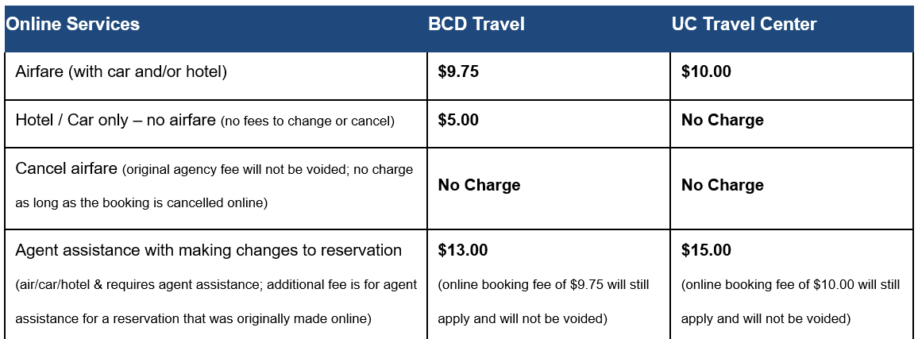
Online Service Fees

Slide 9
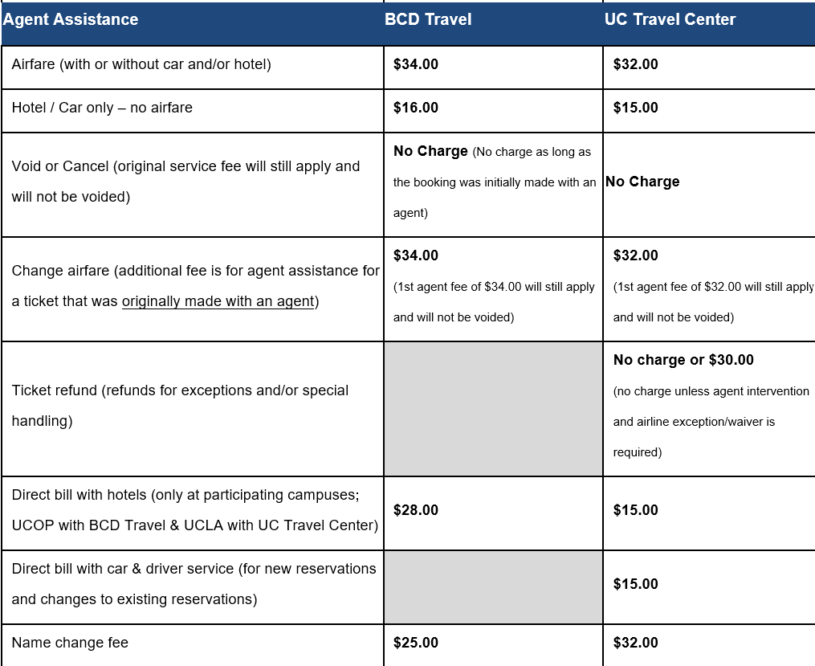
Fees for Agent Assistance

Slide 10
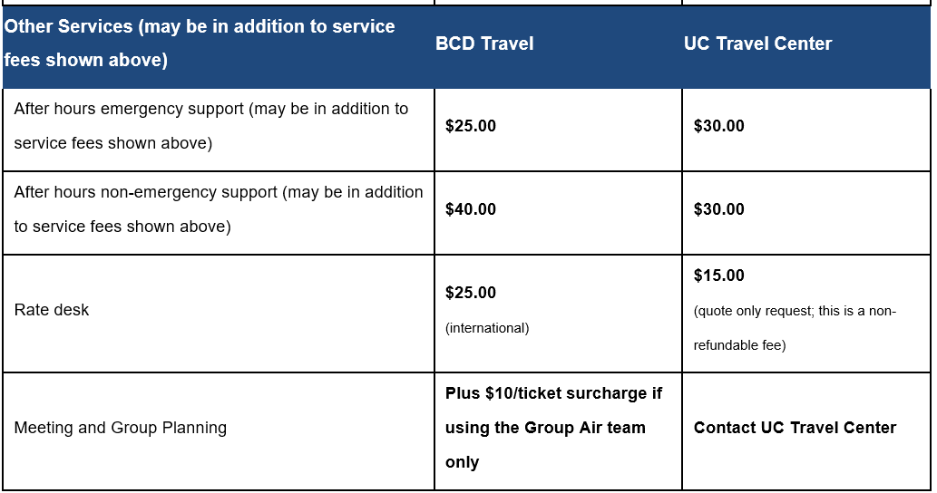
Other Services

Slide 11
Southwest Airlines Integration
March 2022

Slide 12
Southwest Airlines Integration
  As of August 2, 2021, Southwest fares are fully accessible via the Sabre global distribution system (GDS). The benefits include:
  Reduced agency fees – travelers will no longer be charged an additional convenience fee per transaction for Southwest reservations with BCD. The online fee for ALL airfare will be the same at $9.75.
  Southwest inventory – access to 90% of Southwest fares outside of 14 days (excludes special promotional fares) and 100% within 14 days (up from only 40-50% of Southwest fares in Sabre)
  Booking online – nothing changes in the way the traveler books

Slide 13
Southwest Airlines Integration (Cont’d)
  Schedule changes and cancelations – more automated; Southwest notifications will be instantaneous as all other standard carriers
  Prompt receipt of itineraries – once the ticket has been issued by BCD, travelers will automatically receive a copy of their invoice
  Happier callers and better service levels – BCD no longer has to contact Southwest for standard issues so they will be able to serve callers faster and travelers and arrangers will spend less time on the phone.

Slide 14
Car Shortage
March 2022

Slide 15
Car Shortage
Due to the pandemic and travel coming to a standstill for an extended period of time, rental cars became harder to find and rates skyrocketed by 30%.
In an effort to reduce cost, Car rental companies had sold off their fleet.
An ongoing semiconductor chip shortage has resulted in a slow down in car manufacturing resulting in rental companies not being able to fully replace their fleet.
Rental agencies are working to grow their fleet but it is uncertain when the shortages may ease up.

Slide 16
Car Shortage (Cont’d)
The following tips could help to keep the price of your car rental at a reasonable rate:
Use UC’s Negotiated contracts
  Enterprise
  Hertz
  National
  Dollar
  Thrifty
Book through Connexxus
  Ensure your travel profile in Connexxus is up to date with your personal contact information including phone number.
    Car Rental Agencies are calling to confirm reservations at the phone number provided in the reservation.
    Reservations that are not confirmed may be cancelled.
  Carry your UC ID

Slide 17
Car Shortage (Cont’d)
Book Early
  Travelers should reserve a vehicle as soon as the need is identified and be aware of the cancellation policy
Travelers should be encouraged to join loyalty programs with UC preferred providers
  Membership could be the difference between getting a car or not
Consider off-airport rental sites and Ridesharing options
  Affordable rental options may be located at off-site locations
  Avoid airport taxes and fees that come with airport rentals
  Uber Ride or Hotel Shuttles

Slide 18
Updates to UC Preferred Car Rental Agreements
March 2022

Slide 19
National Enterprise Rate Increase
National Enterprise will be increasing the daily rental rates by an average of $4.
There may also be nominal surcharges at select airport location throughout the US/Puerto Rico
What hasn’t changed
Renters will not be charged a surcharge at any off-airport location;
Emerald Club members have the ability to reserve and pay an intermediate car rate, yet still upgrade to any available car type available in the aisle;
There is no additional cost and there is no drop off fee for any one-way rental within California

Slide 20
Additional Agreement Updates/Discussions
Modified agreement also includes various size commercial truck rentals
Discussions forthcoming regarding below market discounts for electric vehicle rentals
Additional updates will be coming
  To sign up for webinars provided by UC Travel visit https://travel.ucop.edu/connexxus/travel-webinars

Slide 21
Emirates Ticket Update
March 2022

Slide 22
Emirates Airline Ticket Updates
  As of July 1, 2021, Emirates no longer offer their airfare inventory in a system that is easily accessible by BCD Travel:
  BCD is working on how to best support the few remaining tickets
  For new tickets, BCD has recommended travelers look at alternate options to Emirates
  Operations at UC Travel Center will not be affected by this change

Slide 23
Group Bookings with BCD Travel
March 2022

Slide 24
Group Bookings with BCD Travel
  BCD Travel updated their internal processes to deal with groups more efficiently and there will now be TWO options depending on group size:
  less than 10 travelers (traditional)
  more than 10 travelers (group air)

Slide 25
Group Bookings w/ BCD Travel (Cont’d)
  For groups of less than 10 people, travel coordinators should email BCD4UC@bcdtravel.com or call BCD directly to book the flights.
  If the CTS card is used, a campus trip/request/direct bill ID for each traveler can be used;
  Travel coordinators can request to be copied on all traveler invoices;
  Booking fee of $34 per ticket will apply at the time of booking;
  Travel Coordinators can also book directly in Concur for the online booking fee of $9.75

Slide 26
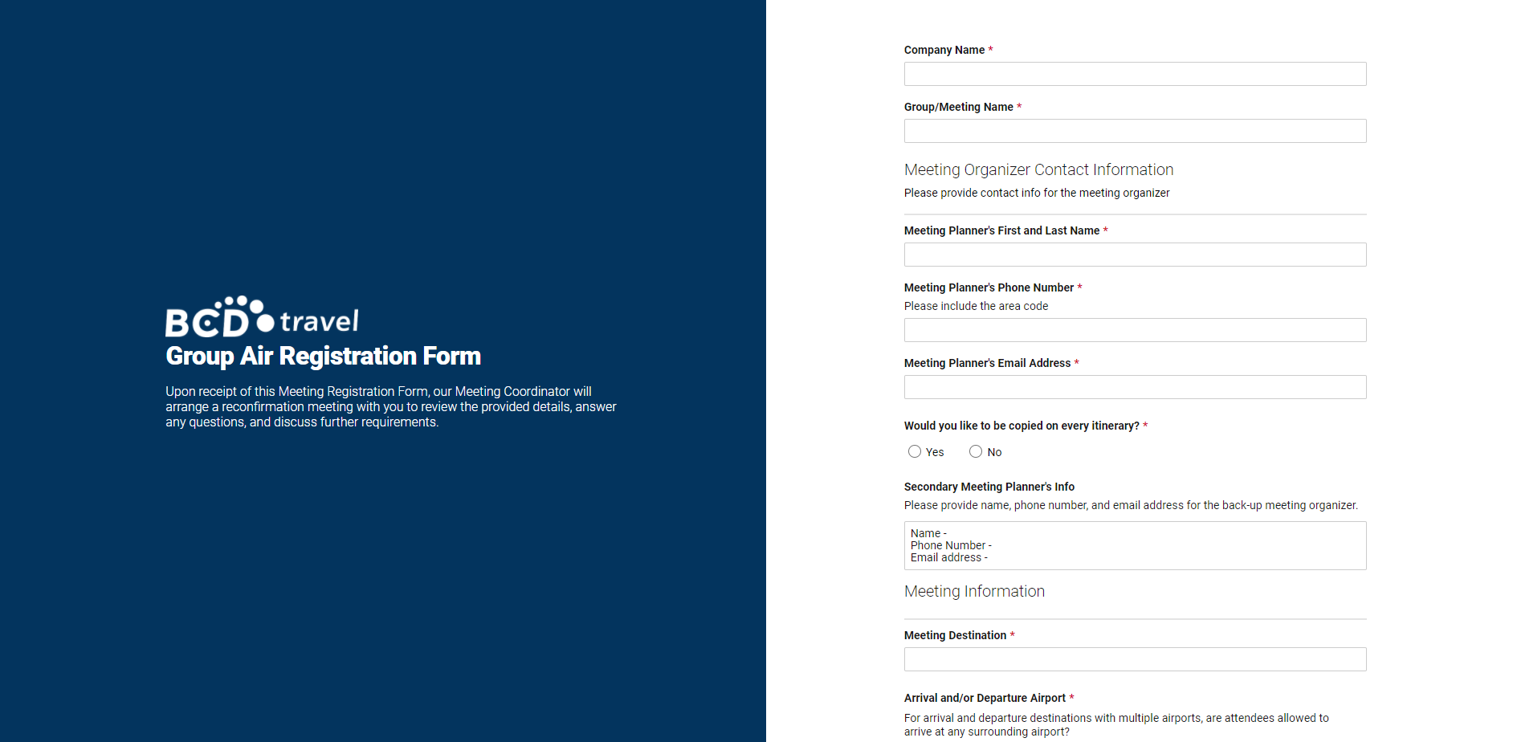
Group Bookings w/ BCD Travel (Cont’d)
For groups of 10 people or more, Travel Coordinators will need to fill out the Group Air Request Form https://app.smartsheet.com/b/form/f0989fd729844edbad10e2fc6731fdbb

Slide 27
Group Bookings w/ BCD Travel (Cont’d)
BCD meeting coordinator will respond within 24 business hours
If the CTS card is used, only ONE unique campus trip/request/direct bill ID (DAPO or PO for UCR) will be used for ALL travelers
NO hotel space will be negotiated or booked
Booking fee of $34 per ticket will apply at the time of booking
An invoice will be generated for $10 upcharge fee per ticket
BCD has programed phone prompt #4 to direct travelers to the Group Air team

Slide 28
General Travel Reminders
March 2022

Slide 29
General Travel Reminders
Please ensure travelers review and understand G-28 Travel policy before traveling to avoid un-reimbursable expenditures
Travel reimbursement requests must be submitted within forty-five (45) days after the completion of travel.
  To ensure travel reimbursement are promptly initiated, reimbursed to travelers and reflected in the general ledger.
  UCR requires a justification after 21 days
Meals and Incidental expenses are based on actuals, not per diem.
Receipts are required for most charges $75 and over
Regardless of dollar amount, original receipts are required to be submitted for the following:
  Airfare
  Lodging
  Rental car expenses
  Registration fees

Slide 30
Insurance - Car Rentals
Car Rental Insurance DO’s
  Utilize the UC agreements whenever possible due to the exceptional pricing and insurance coverage
  Accept full collision coverage for car rentals OUTSIDE of the continental US (OCONUS) and in foreign locations
    Supplemental insurance is also recommended outside of the US
    Costs of additional rental insurance in OCONUS and Foreign locations is reimbursable to the traveler
Car Rental Insurance DONT’S
  Do not accept additional insurances, including collision waiver (CDW) on normal vehicles rented in the Continental United States (CONUS)
    For rentals on the UC agreement, additional rental car insurance is not allowable as it is a duplicative and unnecessary cost
    Additional charges for insurance on non-contract rentals are not reimbursable UNLESS a UC agreement car rental company is unavailable in the travel destination area
    For additional information on rental car insurance coverage, see UC Car Rental Insurance Information. https://www.ucop.edu/risk-services-travel/index.html

Slide 31
Lodging Policy Reminders
Traveler must be at least forty miles or more from the headquarters or home, whichever is closer, before overnight lodging is reimbursed.
Maximum of $275 on nightly room rates for travel assignments of less than 30 days within the continental United States (CONUS).
Lodging expenses are reimbursed for actuals up to $275 per night before taxes and mandatory hotel fees.
Must be supported by original itemized receipts, regardless of the amounts incurred.

Slide 32
Lodging Policy Reminders (Cont’d)
  The cost of the lodging must be reasonable for the locality of travel.
  Lodging comparisons are required when a traveler is unable to secure lodging at $275 or less per night.
  Price comparisons must be:
    Made at the time of booking
    Within the proximity of the meeting that support the higher lodging rate incurred.
  A traveler who is required to attend a conference where the prearranged conference lodging rate exceeds the $275 per night cap may stay at the conference hotel without exceptional approval.

Slide 33
Ancillary Charges
The UC Travel policy, Business and Finance Bulletin G-28 (BFB G-28) allows campus Chancellors to establish local policy on ancillary travel charges.
Effective 10/01/2018, Chancellor Wilcox approved certain ancillary travel expenses in order to streamline the travel reimbursement process.
  Department approval:
    Standard checked baggage fees up to 2 bags
    Carry-on baggage fees up to 2 bags
    Seat selection charges—cannot exceed $30. Does not include seat upgrades
Receipts are required for all charges in excess of $75

Slide 34
Ancillary Charges (Cont’d)
  Department head approval and a written explanation of the business purpose:
    Non-standard checked baggage fees
    Wi-Fi services
    Seat selection charges in excess of $30. Does not include seat upgrades.
    Receipts are required for all charges in excess of $75
  Exceptional Organizational Unit Head Approval and a written justification of the business need:
    Early Bird Check-in or priority boarding
    Seat Upgrade to Economy Plus/Extra Comfort within the economy class airfare or similar -- excludes Business or First Class airfares (see BFB G-28 for policy requirements on business or first class airfares)
    Receipts are required for ALL charges

Slide 35
Donor Cultivation and Recruitment Events
March 2022

Slide 36
Donor Cultivation and Recruitment Events
Effective January 1, 2022, entertainment events held by the President or Chancellors are subject to reimbursement of expenses up to 200% of the listed meal rate limits without requiring additional approval.
The following events can be included
  Donor Cultivation
  Stewardship
  Recruitment
Note: This special rule is only applicable to the Chancellor and would not include events for internal senior leadership or for other non-donor related events.

Slide 37
Impact23 Program Updates - Concur Travel and Expense
March 2022

Slide 38
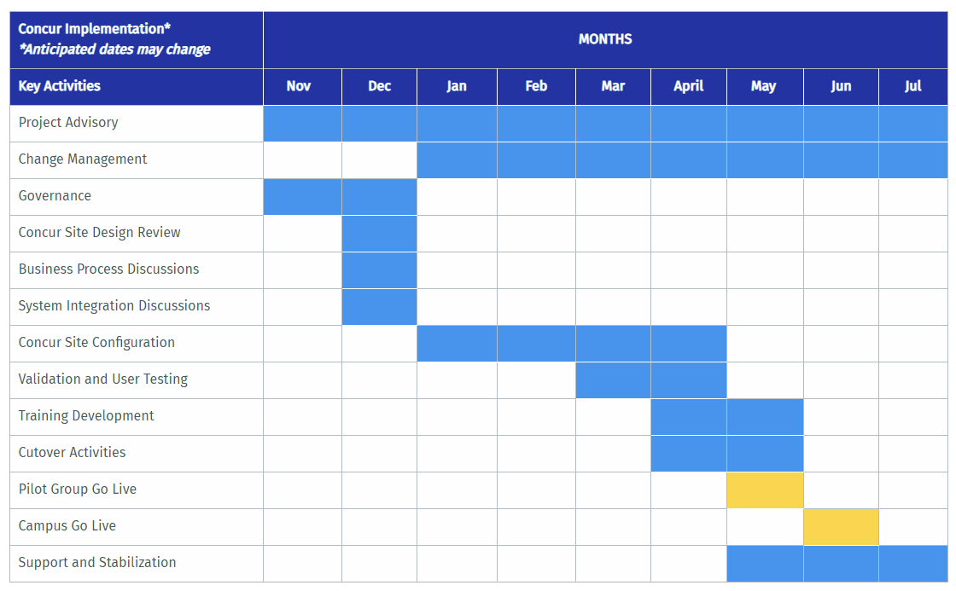
Concur Travel and Expense
Testing and Pilot Group Updates
We are here!
Key Activities
April 2022
Concur Workgroup and Pilot Departments will partake in Concur testing
May 2022
Pilot Department will participate in the Production Pilot
June 2022
Campus-wide Deployment of Concur, issuance of T&E Corporate Cards, the retirement of iTravel (read-only)

Slide 39
Concur Functional Workgroup
Concur Implementation Partner: Huron Consulting Group
Concur Workgroup:
  Lead - Aver Smith, Accounting
  SME - Sandy Danford, Accounting
  SME - Eric Latham, Unex
  SMA - Becki Jo Ray, BCOE Dean’s Office
  SMA - Jaime Matute, Chemistry
  SMA - Jennifer Reising, Botany
  SMA - Mimi Collins, Accounting
  SMA - Shellee Kreuter, School of Medicine

Slide 40
Workgroup Recent Activities
Concur Scope for Phase 1 (June 2022)
  Travel Requests
  Travel Booking
  Travel Expense Reporting (replacing iTravel)
  Travel Management Company (TMC) integration with Anthony’s Travel
  Transition to the T&E Corporate Card for integration with Concur
  T&E Corporate Card Requests
  ProCard Requests
Small workgroup completed initial validation of configuration
Larger workgroup including SMAs completed the first round of User Acceptance Testing

Slide 41
Concur Pilot Departments
Pilot Departments
  Biomedical Sciences
  Botany and Plant Sciences
  Intercollegiate Athletics
  Mechanical Engineering
  Performing Arts (Dance, Music, Theater, Creative Writing)
  School of Business
  School of Education/School of Public Policy
Pilot Departments will participate in end-to-end testing in April and pilot in May

Slide 42
Travel and Entertainment Corporate Card (T&E)
Transition Overview
Prepare
Transition
Travelers apply for new T&E Corporate Card using the online form in Concur, includes:
Support
To ensure the campus-wide transition to the new T&E card, personal-liability cards will be unable to incur new charges starting July 2022
Socialize and encourage travelers to pay off personal-liability card balances. Prior balances must be resolved before a new T&E card will be issued.
Determine who needs to transition to the new T&E card
Direct communication to existing T&E cardholders
in late April
New T&E card expenses must be reconciled in Concur within 30 days of trip completion
New T&E Corporate Card requests and change requests will be initiated through the online form in Concur (e.g., Close/Cancel Card, Update Name on Card, etc.)
Required T&E Corporate Card training available in UC Learning in May
Default FAU for unreconciled charges
Departmental Approval
New Card issuance takes approximately two weeks
Traveler Certification

Slide 43


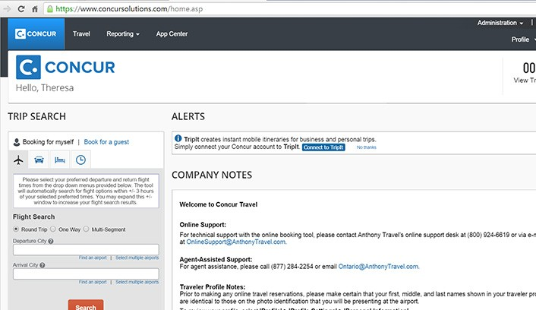


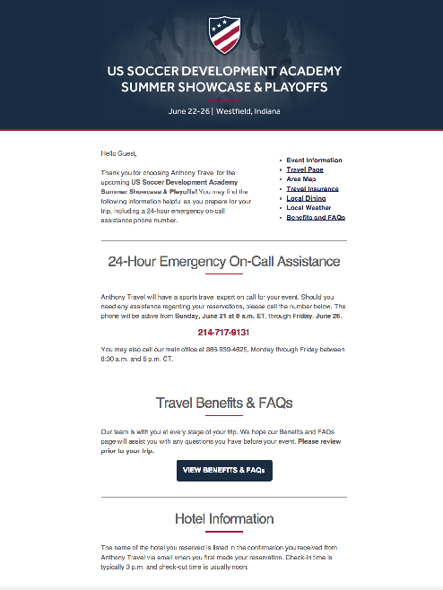
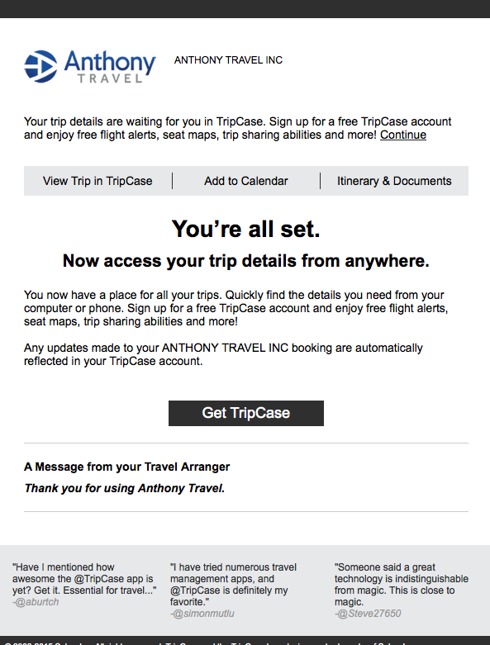


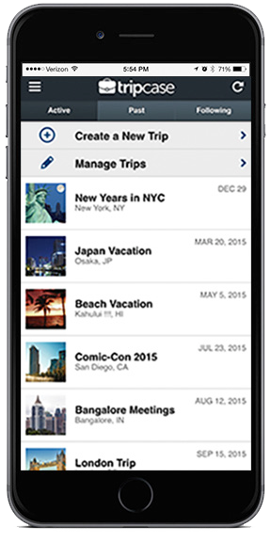



Anthony Travel is the nation’s largest provider of university and sports travel management services. Anthony Travel specializes in university business travel, athletic department travel, and study abroad programs. Anthony Travel provides travel management services by:
Obtaining trip and budget information from your travelers and travel arrangers
Researching travel options
Recommending and booking travel reservations
Streamlining overall processes
Rearranging flights and travel arrangements as needed
Offers agent services or an online booking tool directly in Concur for simpler self-booking travel
24/7/365 support and emergency assistance
The use of Concur/Anthony’s Travel is for business travel only as trips will be charged directly to the university.

Slide 44
Workgroup Recent Activities
Concur Scope for Phase 2 (July 2023)
  Business Meetings and Entertainment
  Other Employee Reimbursements
  ProCard Cost Transfers
  TBD

Slide 45
Q&A

Slide 46

User Group Questions
Smart & Final on Vine St. does not accept PO’s on weekends. Our department discovered this recently. Are there other stores that have the same limit?
  We are unaware of any other stores that don't accept PO's on the weekend but we will follow up with Smart and Final.
Will the travel fees be posted to iTravel?
  These fees are currently posted on Connexxus under the Help section.
I noticed they are charging us agent fees even if the airline has cancelled a flight and we have to call in to make changes
  That is correct as agent fees apply for agent assistance with a booking.
Is there a way to add frequent flyer miles after flight was already booked on BCD? Could the travel do so at the airport as they check-in?
  That would be a question that would have to be directed to BCD. We will have to reach out to determine
Is it possible to get the link again to attend additional updates meetings noted in one of the slides? Thank you
  Links are generated per meeting. Emails are sent prior to the meetings that will include the current link.
Will the departments be getting a list of who currently has a T&E card so we can prepare them for the change and confirm they want to reapply?
  Yes, lists will be sent to select individuals within the department soon.
I had a faculty who just received a Corporate T&E card last week. Will they need to submit for a new one?
  Yes, the card they have is under the T&E personal liability card program.

Slide 47
User Group Questions cont.
Will travel coordinators need to have the T&E card or will this just be for travelers ?
  The T&E card is intended for individuals that travel/entertain at least once per year. Travel Coordinator can apply if they will travel or incur entertainment expenses
During the UCOP meeting that was held yesterday they discussed the rental of electric cars however they mentioned that these cars would fall under the "elite" car. With that being said what is UCR's policy when it comes to reimbursing these elite cars. Will the rental of these cars be reimbursable?"
  As of now we will follow our travel policy G-28 which would make an "elite" car outside of the allowable car rental without exceptional approval or valid business purpose
Can you clarify if a written approval is needed for wi-fi expense while on travel status? Per the memo from the Chancellor Department head approval and a written explanation of the business purpose is needed for wi-fi services
Can we pay Hotel via PO only
  To pay for a hotel via PO you will need to contact the procurement dept who can assist you
I have a traveler arriving next week for our graduate open house. His partner purchased the flight. Is there a way I could reimburse the potential grad for the flight? His name is not currently on the bank account that purchased the flight but he is looking to getting his name added.
  We have this question in our que in travelfeedback. In order to reimburse the traveler we need proof that the traveler physically paid for the travel. The receipt must show their payment information.
Since meals and incidentals must be claimed as actuals and not per diem does this apply to international travel?
  Meals for international travel should always be claimed as actuals up to the per diem amount. CONUS travel should claim actuals up to the cap of $62. Travelers should not claim $62 a day like a per diem unless they exceed that amount each day.

Slide 48
Thank you!

