Slide 1
Travel and ePay User Group Meeting
February 28, 2022

Slide 2
Agenda
General Travel Updates
  Travel Coordinator Training
  Mileage Rate Increase
  AB 1887 Update
  Travel Safety
Unused Travel Credits
Business Meeting and Entertainment Meal Rate updates
Grocery Store PO’s
State of California FTB forms 587 & 590
DocuSign Envelope – Federal W9 & CA FTB Forms
Impact23: Concur Implementation
Q&A

Slide 3
General Travel Updates
Aver Smith

Slide 4
New Travel Coordinator Trainings
Date: Wednesday, March 9, 2022
    10:00 – 11:30
    Will be a short, high level policy overview
    Training will be held via zoom so registration via LMS is required in advance

Slide 5
Mileage Rate Increase
  Mileage rate increase:
  As of January 1, 2022 the reimbursement rate for the use of a private automobile for University business travel increased from 56 cents a mile to 58.5 cents a mile.
  The reimbursement rate for driving an automobile in connection with a move or relocation increased from 16 cents a mile to 18 cents a mile.
  *Note that reimbursements for moving- related expenses, including mileage, are considered taxable wage income as of January 1, 2018

Slide 6
AB 1887 Updates
  New states have been added to the Attorney General’s AB 1887 travel ban.
    AB 1887 prohibits state funded travel to states that have passed discriminatory laws. The law also prohibits requiring employees to travel to these states.
    The following states are currently subject to California’s ban on state-funded and state-sponsored travel:
      Alabama
      Arkansas (7/29/21)
      Florida (7/1/21)
      Idaho
      Iowa
      Kansas
      Kentucky
      Mississippi
      Montana (7/1/21)
      North Carolina
      North Dakota (8/1/21)
      Ohio (9/30/21)
      Oklahoma
      South Carolina
      South Dakota
      Tennessee
      Texas
      West Virginia (7/8/21)

Slide 7
AB 1887 Updates
For more information please refer to the following links:
AB 1887 Prohibited States FAQ
  https://www.ucop.edu/central-travel-management/_files/ab1887-faq.pdf
UCOP Travel Guidance for AB 1887
  https://www.ucop.edu/central-travel-management/_files/ab1887-faq.pdf
Exceptions
  https://oag.ca.gov/ab1887

Slide 8
UCR Travel Safety Guidelines
Be sure to register all of your trips with UC Away
  Trips booked at UCTC or BCD are automatically registered
  If travel is booked outside of Connexxus, travelers need to register your trip at https://ehs.ucop.edu/away/
  If changes are made to a trip, please ensure travelers updates UC Away with changes

Slide 9
Safety Considerations for Travelers
Travel COVID related regulations are continually changing
Localities may have specific travel restrictions in place
  Testing, quarantine requirements, etc.
If traveling by air, travelers should check if the airline requires health information, testing, or other documents
  If testing is required prior to traveling, cost can be submitted for reimbursement at the conclusion of the trip via iTravel.
Travelers should monitor UCR EH&S website and CDC guidelines through out all stages of travel
EHS: https://ehs.ucr.edu/coronavirus/travel
CDC: https://www.cdc.gov/coronavirus/2019-ncov/travelers/index.html

Slide 10
Unused Travel Credits
Dorthea Ford

Slide 11
Unused Credits
If a traveler cancels their ticket, the original booking fee applies. If cancelled after the first 24 hours (void period) the ticket becomes an unused ticket, and the traveler may be able to apply the credit to future travel.
Airlines usually charge a change fee + fare difference. In addition, booking fee(s) will apply to the new ticket.
Cancellations or changes to an airfare should be made with an agent at the respective travel agency (BCD or UC Travel Center)

Slide 12
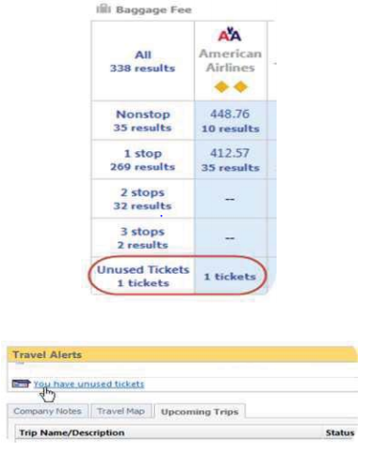
Unused Credits (Cont’d)
BCD: Using Unused Ticket Credits
Travelers with a Connexxus profile will be able to see their unused credits on the home page, flight result page, and the fare results page.
  This information is also visible to the traveler’s designated arrangers/coordinators and BCD Travel full service agents.
Credits are viewable and ready for use within 24 business hours of the trip cancellation.
Credits for profiled travelers are automatically applied when a new trip on the same airline is selected, and the new fare is higher than the credit.

Slide 13
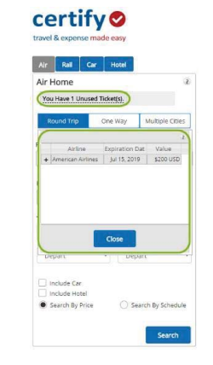
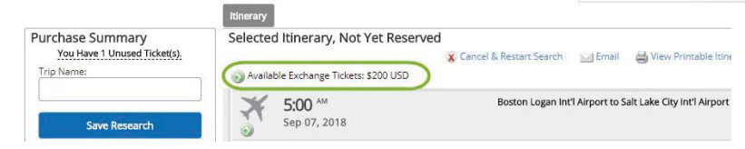
Unused Credits (Cont’d)
UC Travel: Using Unused Ticket Credits From the home page, unused ticket count is displayed.
Unused tickets must be used with the same carrier.
Available Exchange Tickets will appear as a reminder at the top of the screen as travelers/travel coordinators continue with selections.

Slide 14
Unused Credits (Cont’d)
Credit Terms
Each airline determines its own rules and fees for using available credits:
  Most airline fees begin at $200 for domestic tickets or $350 for international.
    Fees for rebooking with credit are not always deducted from the credit itself.
    United/Delta require fees be paid separate from credit.
    Southwest Airlines does NOT charge any fees for using credits.

Slide 15
Unused Credits (Cont’d)
Refunds may be obtained for:
Airfare cancelled within 24 hours of the booking
  Original booking fees still apply
Refundable tickets
  Refundable fares – no credits, full refund;
    Refundable Tickets are generally more expensive
  International Tickets
    Refundable fares with a penalty
      Penalty amount is deducted from the refund amount

Slide 16
Unused Credits (Cont’d)
  UC no longer has a designated BCD team.
    All calls now go to a general line.
  BCD will charge a $50 per hour fee (on top of the booking fees) for any name changes to utilize credits for another traveler.*
  Fee cannot be charged at the time of ticketing but is charged to the Accounting Office on a monthly basis which will be recharged to departments.
  * Name changes allowances are dependent on the airline.

Slide 17
Business Meeting & Entertainment Meal Rates
Dorthea Ford

Slide 18
Business Meeting & Entertainment Meal Rates
Office of the President announced incremental changes to meal rates covered under BUS-79. The revised business meetings and entertainment meal maximum per person amounts are applicable for expenses incurred on or after the effective dates noted below:
BUS-79 Meal Type Maximum per Person | 1/1/2016-10/31/2021 | Effective 11/1/2021 | Effective 1/1/2023
Breakfast | $27 | $28 | $29
Lunch | $47 | $49 | $51
Dinner | $81 | $85 | $89
Light Refreshments | $19 | $20 | $21
Note: Travel maximum reimbursable meal rates have not changed.

Slide 19
Grocery Store PO’s
Dorthea Ford

Slide 20



Grocery Store PO’s
As of Sep 15, 2021 Stater Bros grocery stores have stopped accepting PO’s for business purchases.
The following stores still allow purchases via PO:
Goodwin’s Organic Foods
Ralph’s Account Closed 3/2/22
Smart & Final

Slide 21
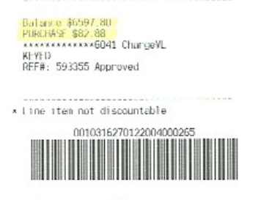
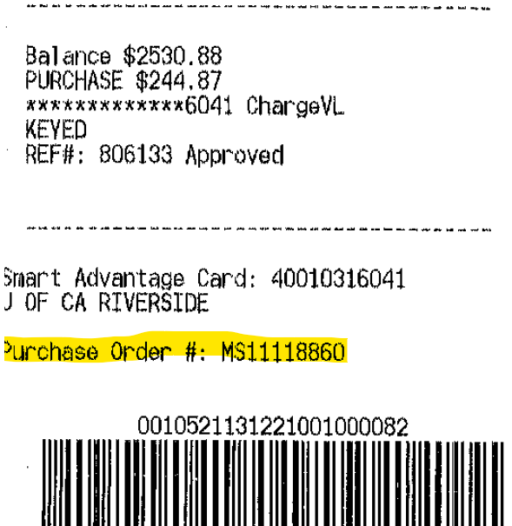
Grocery Store PO’s (Cont’d)
Smart & Final (Cont’d):
  Include account number (60124600010316041) on the DAPO
  Ensure that all individuals making purchases are advised to ensure the Cashier notes the DAPO# on the receipt
    Failure to do so may result in a credit hold preventing future use of this vendor by the campus community
INCORRECTDAPO Not included
CORRECT DAPO included
MS11999999

Slide 22
Grocery Store PO’s (Cont’d)
Smart & Final (Cont’d):
  Smart and Final will place the University on a campus-wide hold for delayed payments. Please ensure the following:
    ePay PO Back-up for all Entertainment purchases are submitted and approved promptly at the conclusion of the event to avoid payment delays
    Please make sure to have executed PO in hand when shopping, as the PO number is required to be keyed at the register by the cashier.
    Cashier must receive approval from Smart & Final’s Credit Dept before order can be completed. If UCR has outstanding payments, the purchase may be declined. Please ensure your department follows the procedures to allow the university to take advantage of this privilege.

Slide 23
State of California Forms 587 & 590
Mimi Collins

Slide 24
FTB Forms 587&590
Certain payments to Non-California Residents of $1500 or more in a calendar year may be subject to 7% withholding by the California Franchise Tax Board
  UCR requires either a form FTB 587 or 590 regardless of dollar amount being paid.
    587 –Non Resident Withholding Allocation Worksheet
    590 –Withholding Exemption Certification
UCR is required to withhold unless we receive one of the following:
  Form 590 (withholding Exemption Certification)
  A waiver from the FTB
  An approved reduced withholding amount authorized from the FTB is provided prior to disbursement.

Slide 25
Payment Types requiring State forms
Honoraria
  Payment should not exceed $3,000 and should align with purpose of payment.
  For non-employees and non-UCR students only
  Should be a “One-time” gesture to an individual based on define participation criteria
    DBA’s or Business cannot receive this payment type.
Human Subject
  Direct payment made to Human Subject participants
  Must be substantiated by a signed certification from the Human Subject
  Should not be used for reimbursement to individuals who have made payments to Human Subjects
Performance Agreement
  Signed and approved Performance Agreement attached in ePay
  Name on state form must match Artist on agreement exactly
  If FTB Form does not match Artist on agreement, request will be returned
  Requests for special handling must be outlined in signed agreement

Slide 26
Payment Types Requiring State forms (Cont’d)
Stipend
  Non-UCR Student and Non-Employee payments for participation in University Program
  Purpose of Stipend must be included
  UCR Student payments should be processed through Financial Aid
Game Official
  Game officials at athletic event
Homestay
  Payments to hosts of foreign students attending classes and living in private homes in the community
Casual Labor
Misc Agreements / Contracts
  Teaching Agreements, etc.

Slide 27
587 & 590 Common Errors
Incorrect Tax Year Form
  The year of the form should match the year the recipient is signing for an exception.
    590 – Once form is accepted, it is valid until the recipient information changes.
    587 – This for is only valid for the specific agreement the form was received for. A new form is required for each new agreement / project.
Invalid, missing or incomplete Withholding Agent information
  Withholding agent will always be the University of California Riverside. Any other information placed on the withholding section will cause the form to be invalid.
SSN / FEIN not provided
Incomplete mailing address
Incomplete Name or Name doesn’t match vendor file
  The name reflected on the CA FTB form must match the vendor ID used in ePay or the physical performer shown on the performance agreement
Invalid Signature / Not Signed
  DocuSign or Wet Signature are the only allowable forms accepted.
  Adobe Signature is not allowable.

Slide 28
587 & 590 Acceptance Requirements
California Non Resident Withholding requirements has been an ongoing pain point for all parties involved.
A basic guide has been developed to offer:
  Examples of Performance Agreement scenarios
  Payment types that may require Non Resident Withholding
  FAQ’s
  Samples of correct forms vs incorrect forms

Slide 29
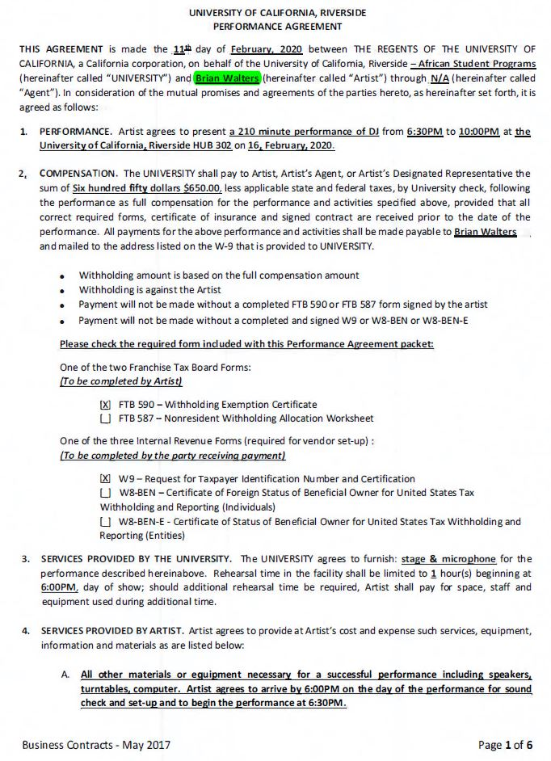
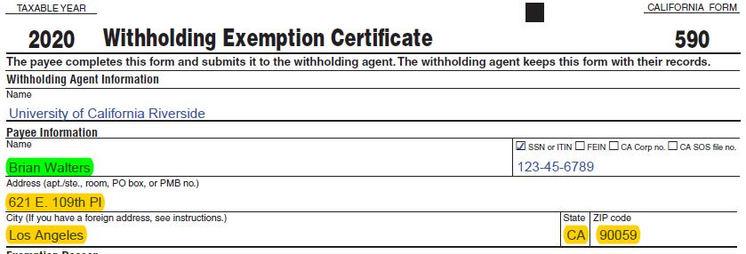
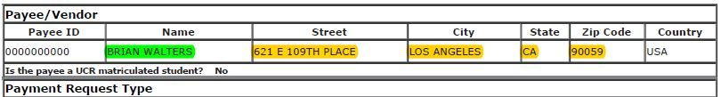
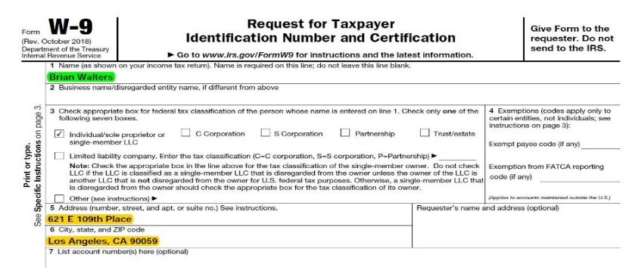
587 & 590 Acceptance Requirements
Performance Agreement Direct Payment to Artist

Slide 30
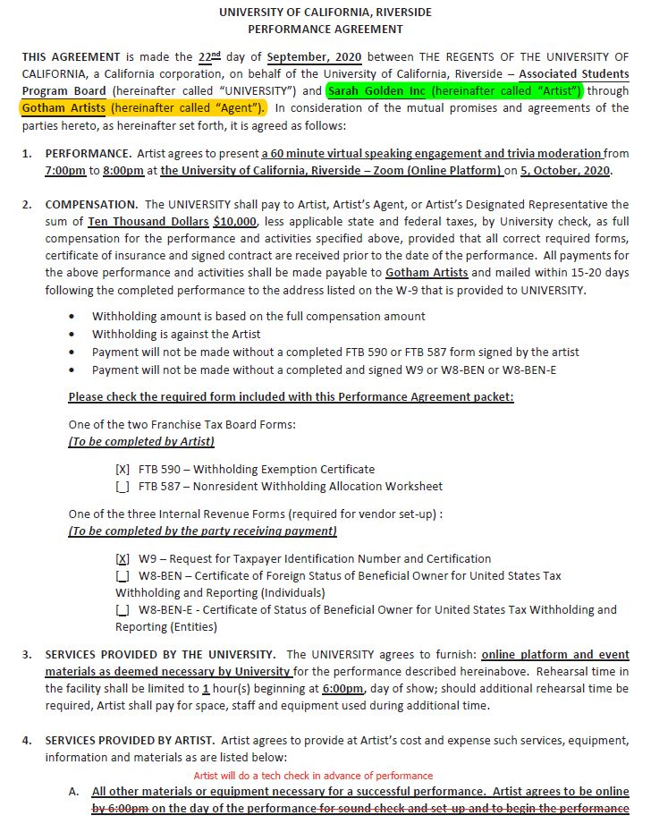
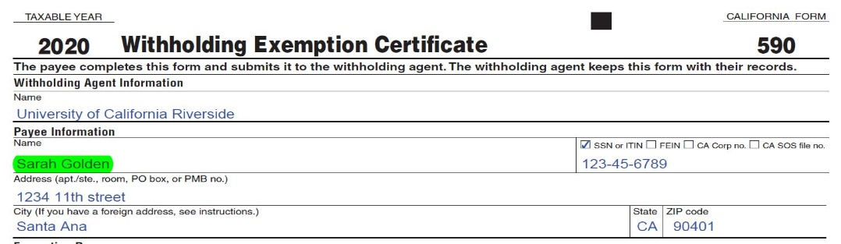
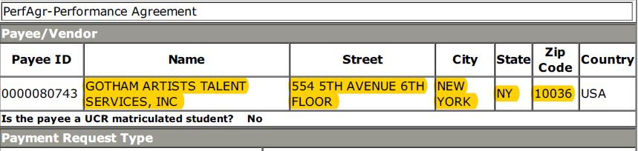
587 & 590 Acceptance Requirements (Cont’d)
Performance Agreement Direct Payment to Agent

Slide 31
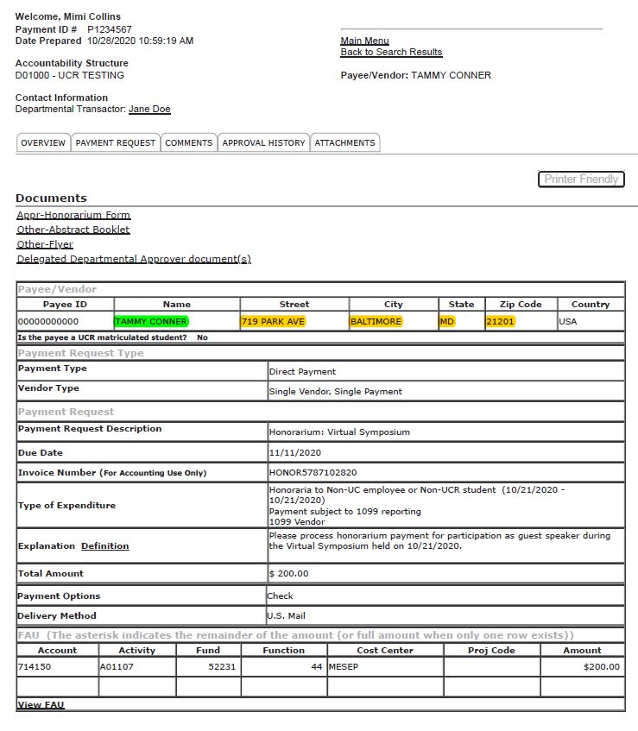
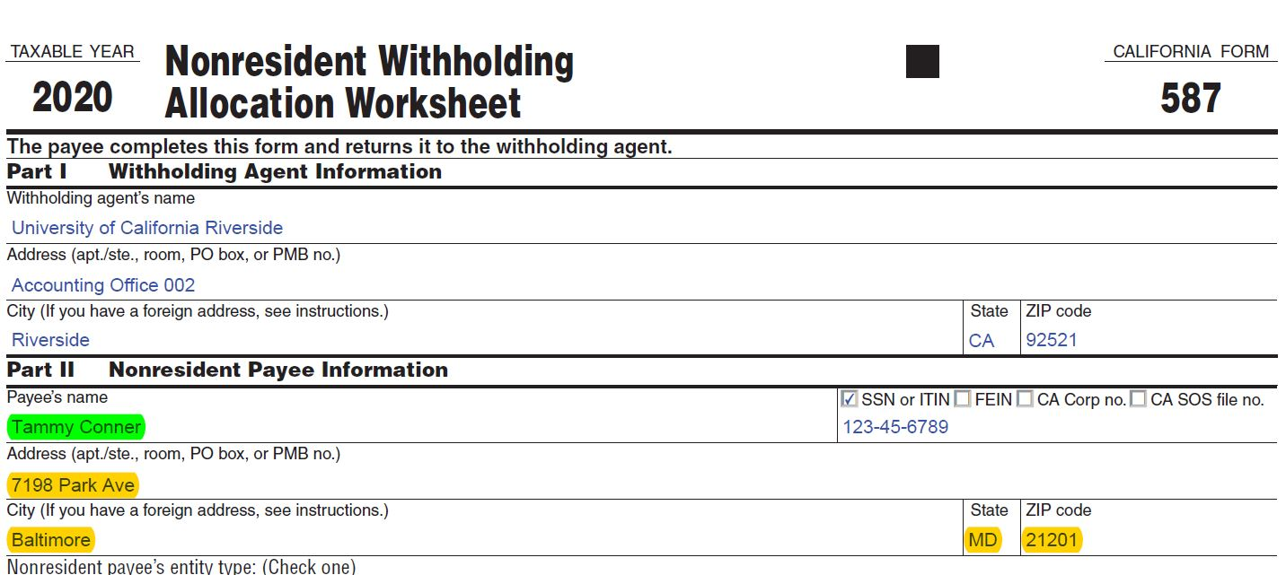
587 & 590 Acceptance Requirements (Cont’d)
ePay 1099 Payments
Honoraria
Human Subject
Stipend
Casual Labor
Game Official
Homestay

Slide 32
DocuSign Envelope
Mimi Collins

Slide 33

DocuSign Envelope
In an effort to streamline the Federal W9 and CA FTB forms process, a DocuSign envelope has been created. This envelope will provide assistance to the recipient and ensure proper routing of documents upon finalization.

Slide 34
DocuSign Envelope (Cont’d)
DocuSign envelope will assist with:
Providing assistance to recipient to ensure forms are completed in entirety and appropriately.
Ensuring the signature is acceptable.
Ensuring the tax year for CA FTB forms match the year the form is completed.
  Example: 2018 form cannot be used for payments made in 2022
Ensuring proper routing to Accounting Office team.
Tracking for departments on when forms are completed by recipient and approved by the Accounting Office.

Slide 35

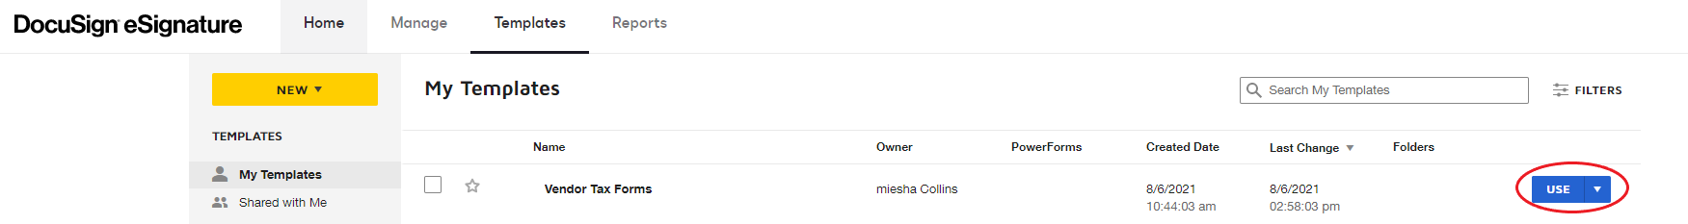
DocuSign Envelope (Cont’d)
Envelopes can be located under the “Templates” section
Select “Use” Button located to the left of the “Vendor Tax Forms” template

Slide 36
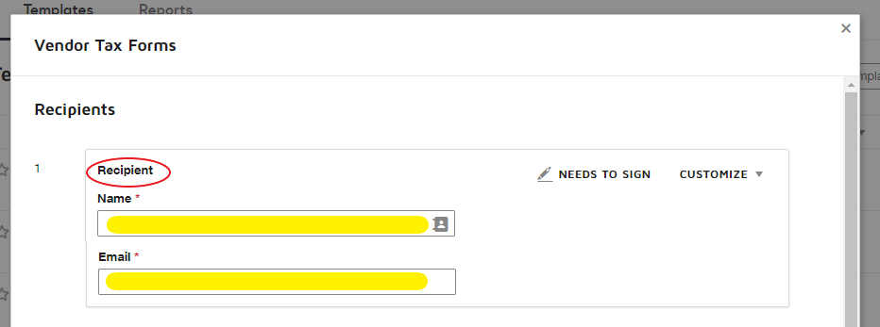
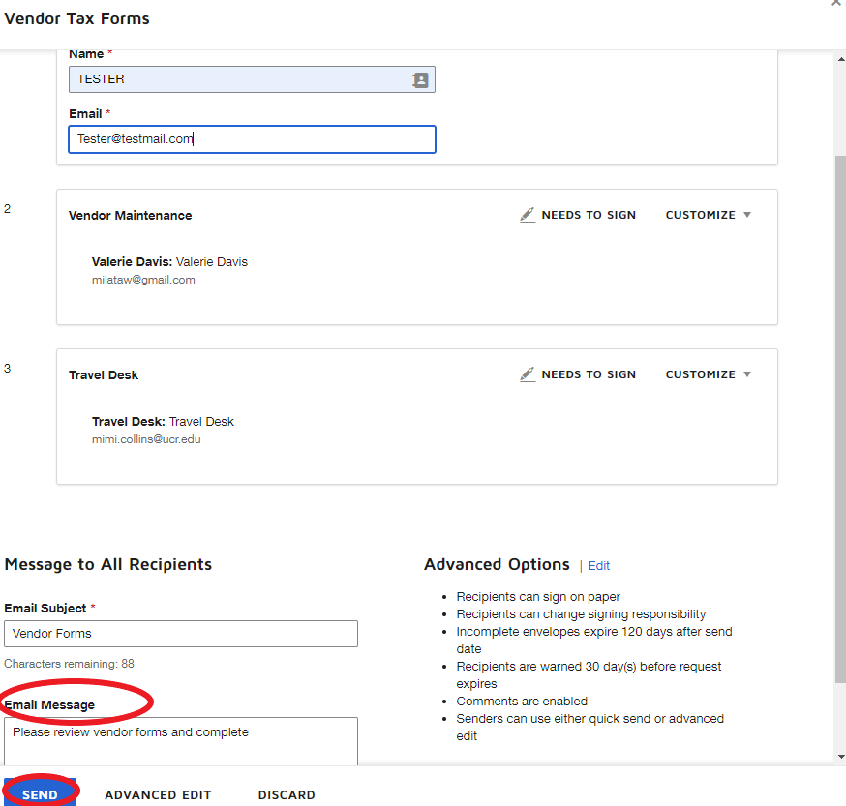
DocuSign Envelope (Cont’d)
Enter recipient information. Routing is automatically generated.
Type a message to the recipient
Click “Send”
Routing
Recipient
Vendor Maintenance
Travel Desk
This process eliminates need to send a copy to AP. Tax forms should never be emailed.

Slide 37
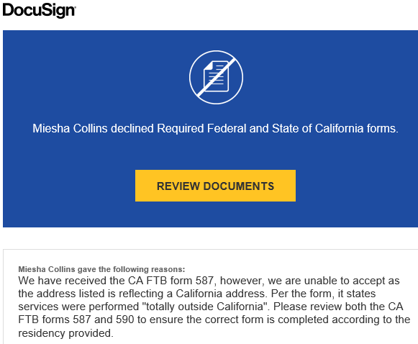
DocuSign Envelope (Cont’d)
If forms are not accepted for any reason, an email from DocuSign will be returned to the sender citing the reason. To resend for correction, select “Review Documents”

Slide 38

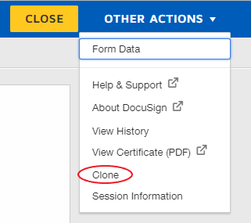
DocuSign Envelope (Cont’d)
Once the Document opens, select “Other Actions”
From the drop-down select “Clone”
This will copy your initial request and allow you to resend to the recipient to complete the form again. Please make sure to update the “Email Message” to provide clarification to the recipient what is needed and then select “Send Now”

Slide 39
Travel User Group
Impact23 Update
February 28, 2022

Slide 40
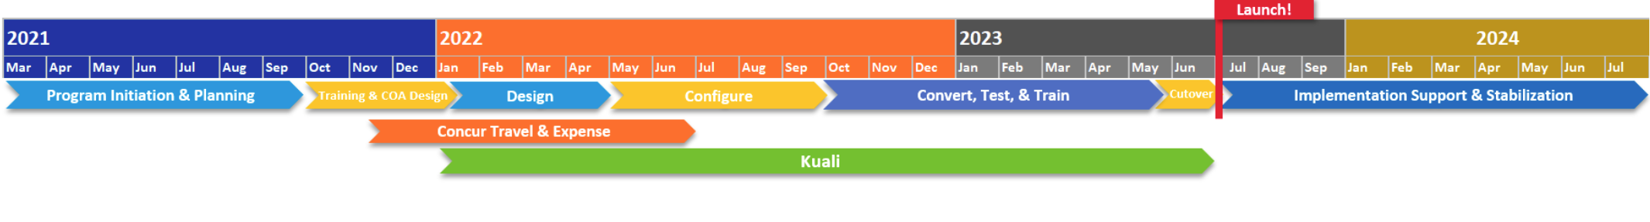
Impact23 Program
Modernizing UC Riverside’s Financial Systems
We Are Here!
Concur Launch!
The Impact23 program is a multi-year initiative that will transform how UC Riverside (UCR) transacts, develops budgets, tracks spending/revenue, and performs financial reporting. Replacement financial systems to include Concur, Kuali, and Oracle.
UC Riverside will implement a revised Chart of Accounts when we launch the Oracle financial system in July 2023.
To standardize UCR’s technology and better meet the University’s long-term needs, existing homegrown systems
(i.e., eBuy, iTravel, etc.) will migrate to new technology as part of the transition to a new enterprise financial system.
The Impact23 website is your primary resource for program updates, tracking deadlines, and engagement opportunities
such as training and events.
Notes:
Phase 1 of Concur launch is on a earlier launch than Kuali and Oracle
Phase 2 of Concur launch which may include reimbursements will be in line with the new financial system launch in July 2023
All Impact23 updates and key departmental activities and deadlines will be posted on the website: impact23.ucr.edu

Slide 41
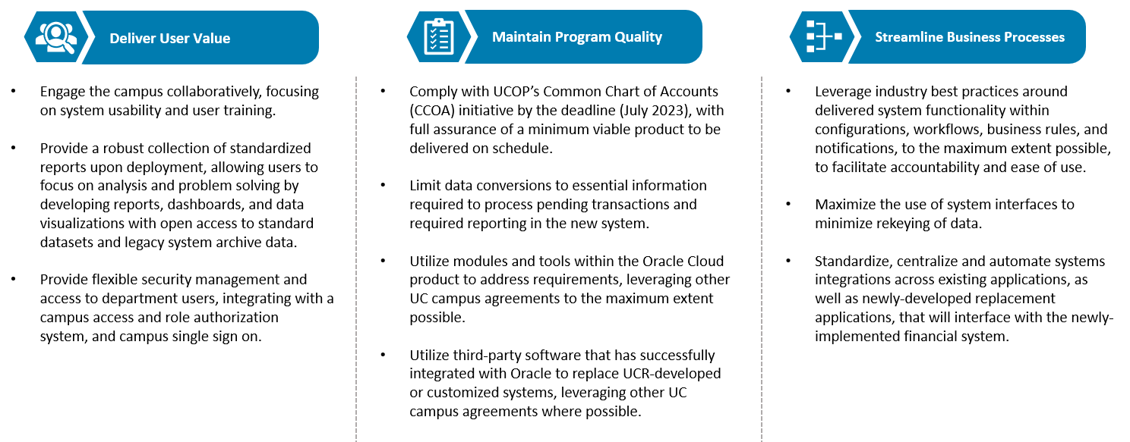
Mission & Guiding Principles
Notes:
May be changes in the way that we are used to doing business
Standardizing UCR processes to align with native system functionality

Slide 42






Why Concur Travel and Expense?
Leading T&E technology – used widely by higher-ed and UC system
Robust mobile functionality for travel booking, receipt management, expense reports, approvals, and itinerary management
Automated expense report functionality
Analytics, dashboards, and audit rules
Continuous technology enhancements

Slide 43
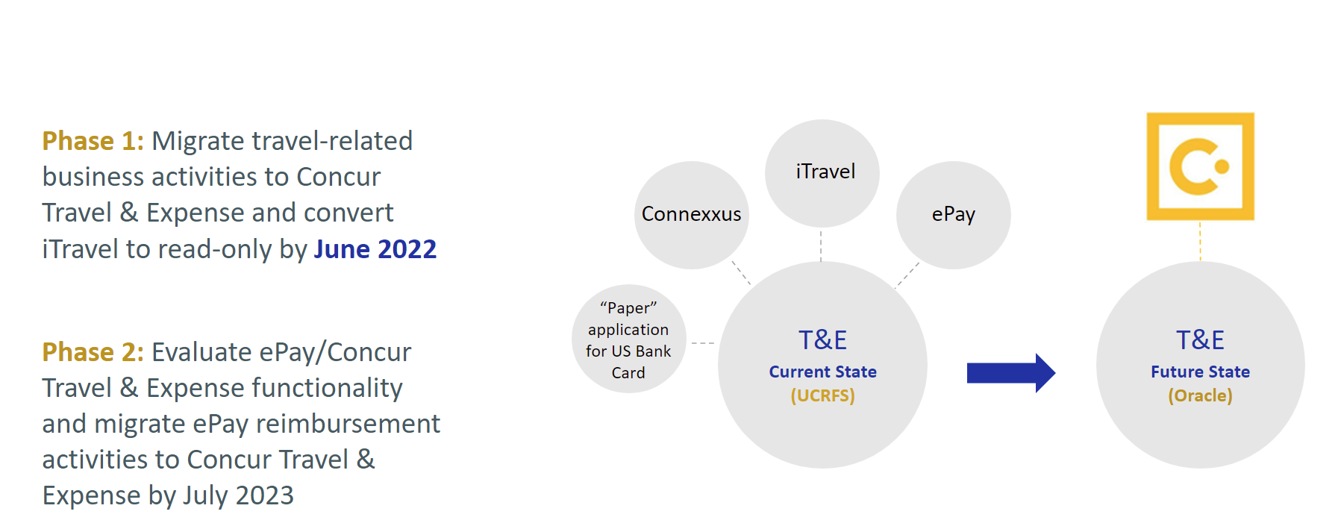
Concur Travel and Expense
The Future of UCR Travel and Expense Management​
Notes:
In Current state all these separate T&E related processes are feeding into our financial system UCRFS
Future state our T&E activities and card programs will be managed through a central portal (Concur) which will be integrated ino our financial system Oracle
Read Phase 1 & 2

Slide 44
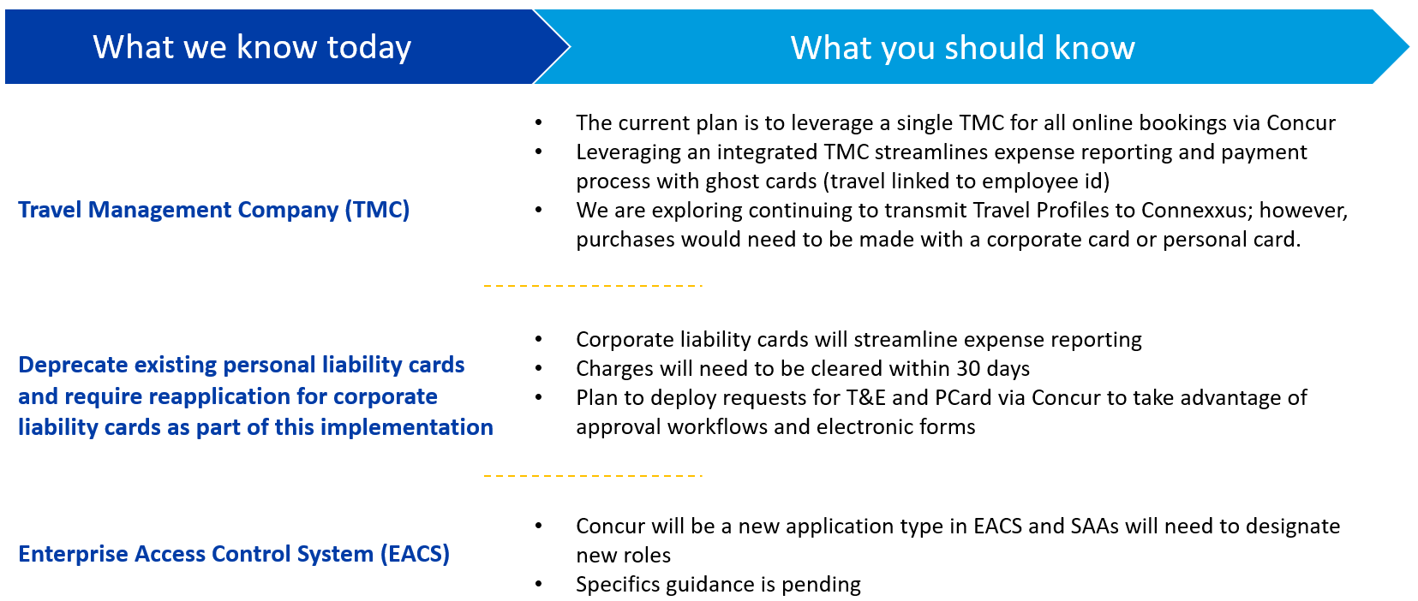
Concur Travel and Expense
System Implementation Updates

Slide 45
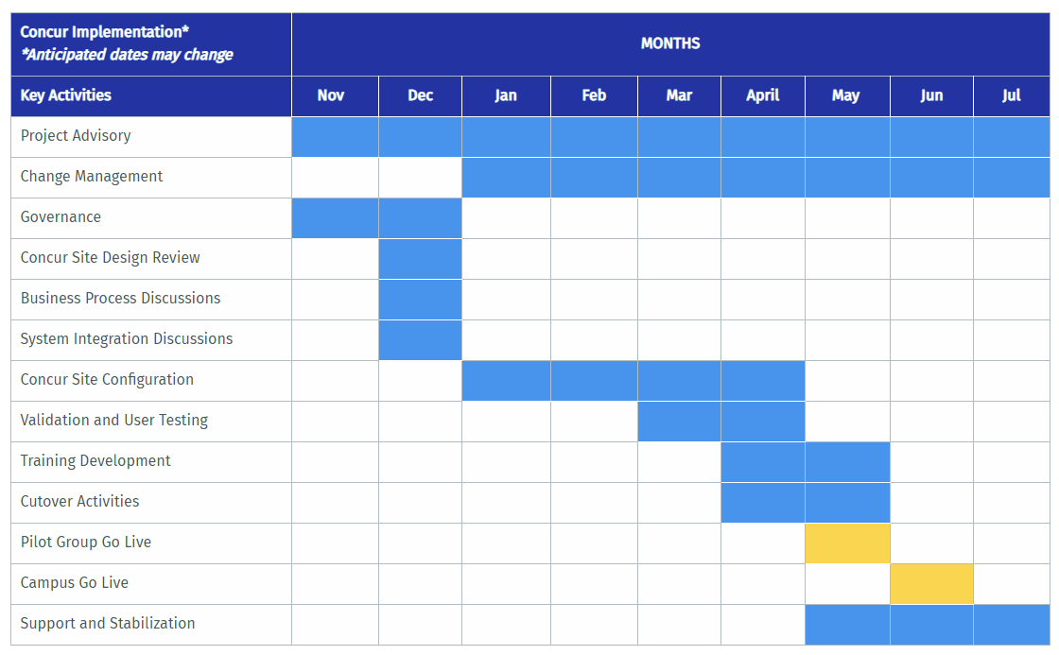
Concur Travel and Expense
We are here!
Phase 1 Timeline
Notes:
Gone thru preliminary confirguation testing with several more testing cycles to come
Testing is the primary activity during March and April

Slide 46
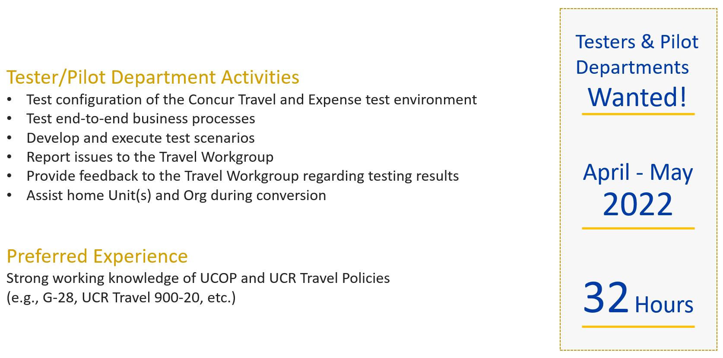
Concur Travel and Expense
Tester & Pilot Department Nomination Process
Notes:
Currently in the process of launching the Testing and Pilot nomination process
We are looking for whold departments to participate, If interested in becoming a pilot department, communicate your interest with you CFAO

Slide 47
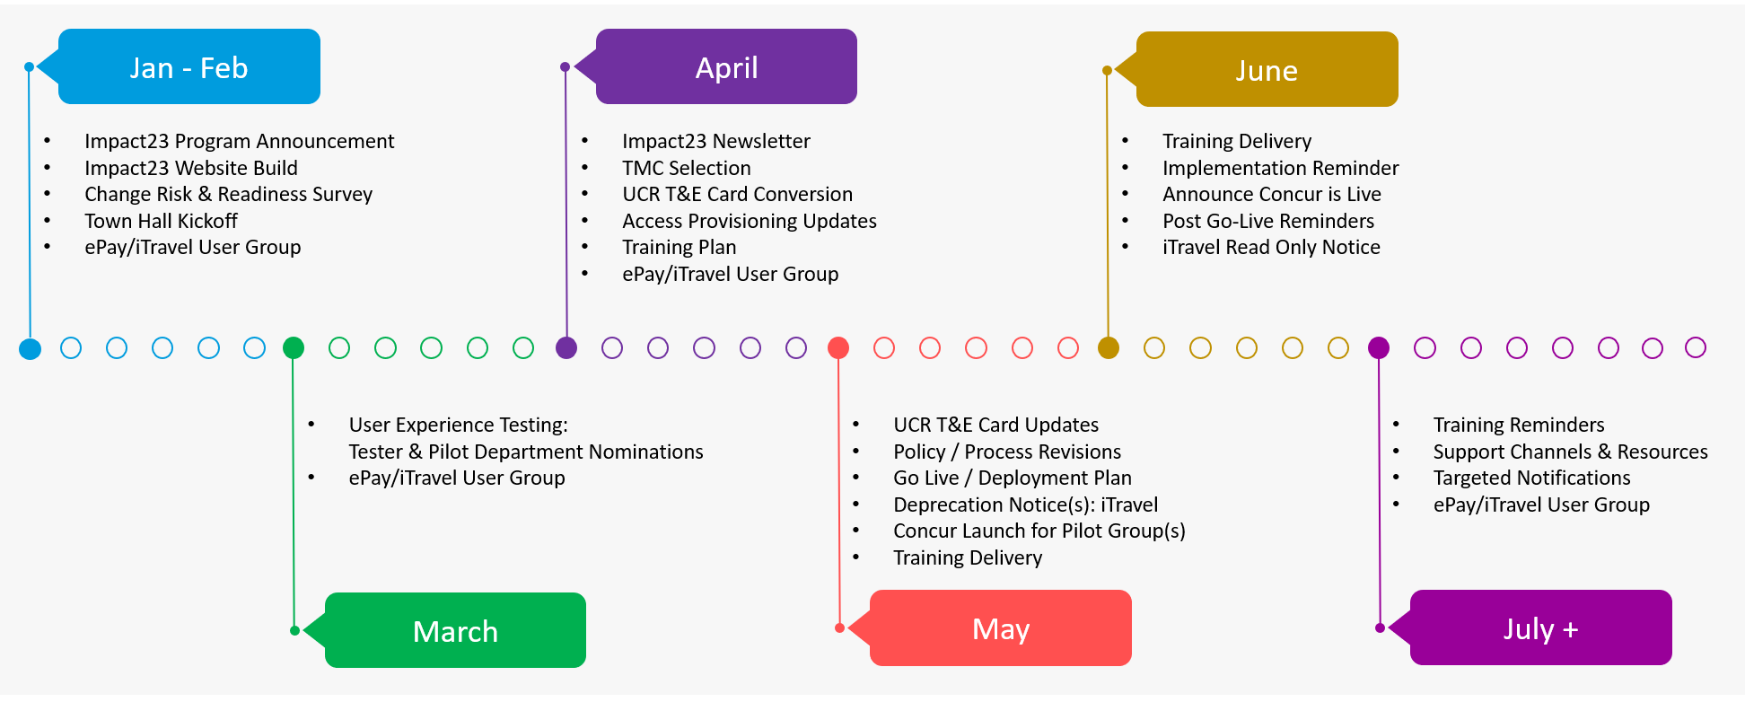
Concur Travel and Expense
Communication and Engagement Plan
Notes:
We are here. This is a roadmap of the Concur rollout and upcoming activities through system launch
Jan & Feb is completed
Focus on March

Slide 48
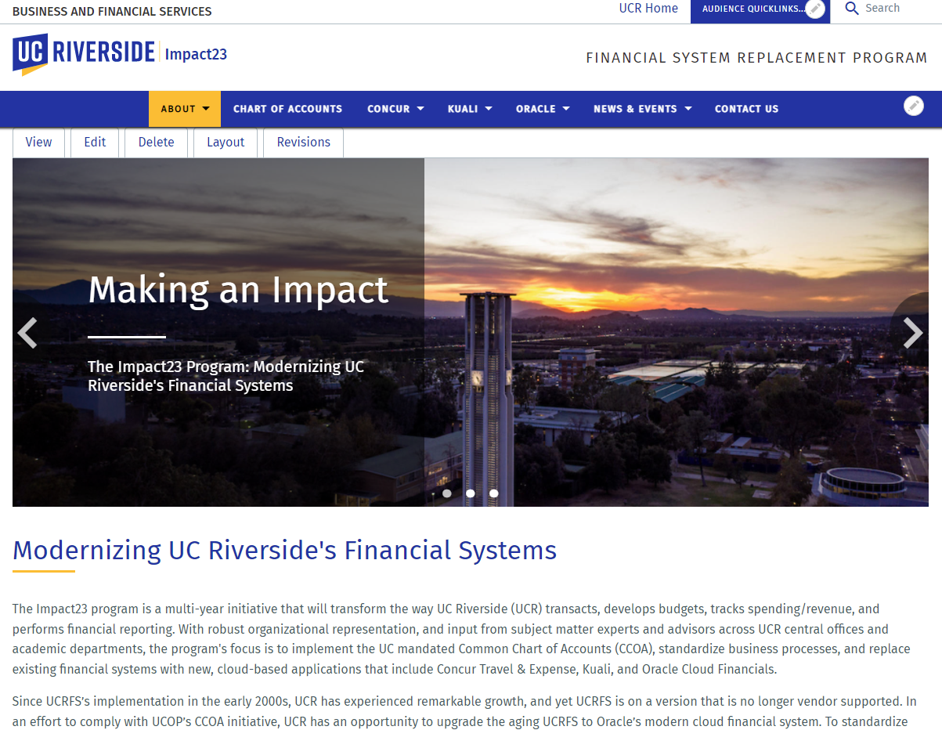
Impact23
Brand
Approved by the
Impact23 Steering Committee in
December 2021
Notes:
Where to find the information on the website

Slide 49
Impact23
Website
Overview
About:
About the Program, Survey & Latest News
Program Team
Change Management
Program FAQ
Replacement Systems:
Scope, Timeline, Key Design Decisions, Cutover, Training, Support
Impact23@ucr.edu
News Archive
Training & Event Registration
Town Halls
Chart of Accounts:
UCOPs CCOA, What is a COA, Why we are updating UCRs COA
Link to Website:
https://impact23.ucr.edu
Notes:
Here is how to navigate the website

Slide 50
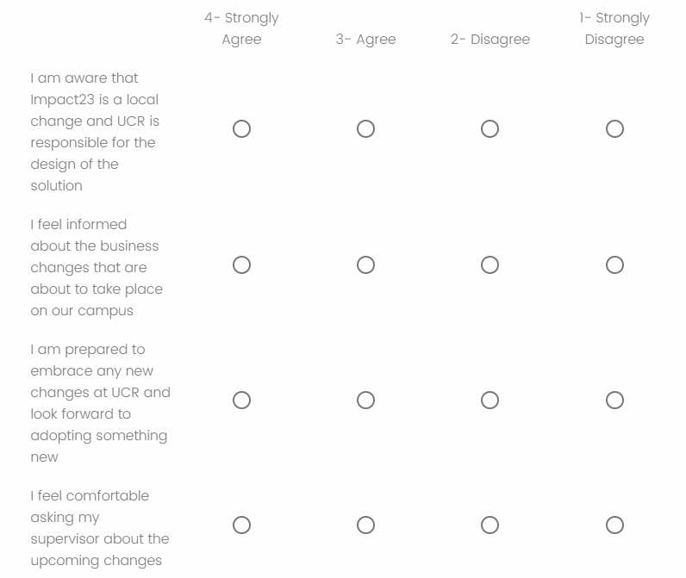
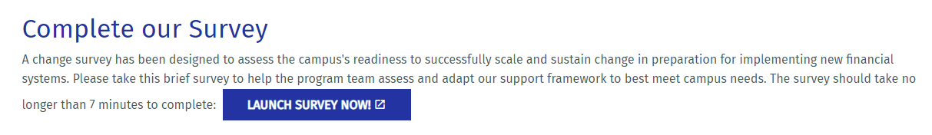
Users Group Support
Visit Impact23 Website
Complete Survey by 3/4
Participate in future Concur-related activities
Notes:
How can you support us? Go to the website

Slide 51


Slide 52

User Group Questions
Will the slide deck be emailed or posted later?
The slides will be uploaded onto our Accounting Website along with all other past user groups.
How do you do a name change for tickets?
Name changes are not allowed for all airlines and would depend on the airline policy. Any name changes will require a direct call with the agency used (BCD or UCTC) to assist.
Is there a way we can set up non-UC employees to book airfare through Connexxus? I couldn't find info on the websites.
Individuals must have a UC email address in order to book directly through Connexxus. However, a Travel Coordinator can book on behalf of a non UC employee by booking as a "Guest".
What does SFI charge on the Smart & Final receipts mean?
This is noting that UCR's account with Smart and Final has been charged. UCR will be receiving an invoice to make payment for the items purchased.
Human subject: What certification needs to be signed?
The individual should review the instructions for both CA State FTB forms and determine which form would apply to their unique tax circumstances and residency.

Slide 53
User Group Questions cont’d
Can the Spanish tax form templates (W9) also be added?
Spanish W-9: https://www.irs.gov/pub/irs-pdf/fw9sp.pdf
Spanish CA State Forms are not offered on the state of California Website.
If booking a flight for conferences do we still use Connexxus to book the flight?
Yes. Connexxus should be used to eliminate out of pocket fees for the traveler due to our current travel restrictions and cancelation of in-person conferences. A refundable ticket might be the best purchase at this time.
What should be the subject title when sending these 590/587 forms through DocuSign? Should we also send them as we get them or should we wait to send them once ePay is submitted?
The subject title should be 590/587 Form – Name of recipient. If you are utilizing the DocuSign envelope, the subject is generated with only the name needing to be added.
Please send them as soon as you get them to ensure we have all the information.
Would it be beneficial for current Travel coordinators to take this training on Wednesday, March 9, 2022, since it will be different?
It would be beneficial as a refresher course; however, it will not be new information.

Slide 54
User Group Questions cont’d
Can we use the Pro-Card to make purchases? Are we still able to book hotel rooms using the Pro-Card or will they need to pay with their own CC?
Lodging can be booked on your Pro-Card, however, it is important to ensure that the hotel only charges the lodging rate and all other additional charges (i.e. meals, parking, etc.) are charged to the travelers personal card. If they cannot ensure additional charges will not be charged, a Pro-Card would not be the best option. Also, please review previous user group on Pro-Card charges for lodging.
How do we go about adding more Ralphs and Smart & Final stores other than those listed in the system?
Our PO's should be accepted at all locations.
Ralphs is no longer a UC Grocery vendor and should no longer be used.
How to we make sure Smart and Final receipts reference the PO number by the cashier?
Please make sure you ask the cashier to reference the PO on the receipt.
With the rollouts coming up in June 2022, what are the potential positive or negative impacts for fiscal closing?
The volume of travel is not at pre-pandemic levels. We hope this will allow travelers and coordinators to become comfortable with the system before travel picks up. We encourage departments to get travel expenses in as soon as possible in iTravel to avoid large volume push in the new system. We do not anticipate this having a sever impact on fiscal closing.

Slide 55
User Group Questions cont’d
Is the maximum amount for honorariums (without exception approval) currently $3000? Last I heard it was $1500.
$1500 is without additional approval, over that amount requires additional approval, however, the max is $3000.
Is there additional account numbers we need to add to the PO like we do for S&F? Smart and Final Account #60124600010316041.
Adding the account number on the PO will be helpful, however, it is important that we ensure the cashier add the PO# at the time of checkout. As for Goodwins, there is not additional account number that needs to be provided.
Can you clarify, if a faculty member has made payment to a Prolific account or Amazon Turk for human subjects and submitted a receipt for reimbursement, are tax forms still needed?
In order for AP to process payments directly to the Human Subject, we require that form. However, it is important to note that would be a departmental determination should your project be audited. We in AP will not require them.
Can this PowerPoint be emailed to us?
PowerPoint will be uploaded to the Accounting website under our previous user group meetings.

Slide 56
Thank you

