Slide 1
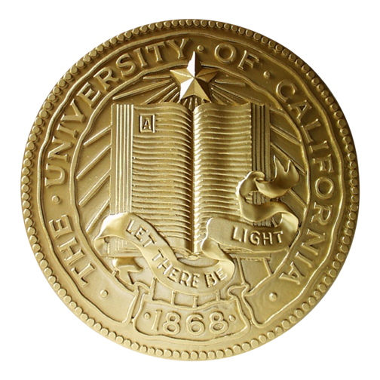

Lunch-n-Learn: Endowment & Investment Accounting
Presented By:
EIA Team
March 29, 2012

Slide 2

Terminology Highlights
A True endowment (TE) is a transfer of money or property donated to the University whose donor has stipulated the fund principal must remain inviolate and only the payout may be expended or alternatively reinvested. This allows for the donation to have an impact over a longer period of time than if it were spent for current use all at once.
By contrast, a Fund Functioning as an Endowment (FFE), is a fund where the fund principal is set aside to be invested in the manner of an endowment. The principal is held inviolate, however, as there are no legal restrictions on expenditure of principal, the decision to hold principal inviolate may be overturned with donor or administrative permission.
Notes:
Winner gets a candy bar. (two questions, one winner per question)
1. guess approximately how many True Endowments = 2,744 and
2. the current market value of True Endowments we currently have = $2.63 Billion
Inviolate: in perpetuity

Slide 3
  Regents Endowments Today
  2,744 True Endowments
Market Value = $2.63 Billion
  2,110 FFE’s Market Value = $3.42 Billion
  87 External Trusts Market Value = $0.24 Billion
  281 Planned Giving Funds Market Value = $0.07 Billion
  Current Market Value @ 2/29/2012 = $6.36 Billion.
Notes:
The Tompkins gift was 47 acres of land here in Oakland – the University was to sell some/all of the land until the University had $50,000 “in gold coin.” This would then be invested with the income supporting the salary of a professor.
This wasn’t reached until many years later, and the first Agassiz chair was appointed in 1895. The chair was assigned to Berkeley by the Board of Regents in 1933 (up until then, it was assumed that the University WAS Berkeley). In 1999 – when the Chair had a value of about $5.5 million – it was split into 4 Chairs (Chinese 500k ($569 k), Japanese 500k ($569 k) , Visiting Professor 1.0 m ($1.1 m), and 1872 Administrative Chair 3.5 m ($5.5 m).

Slide 4
Agenda
  Mission Statement
  Organization Chart/Location
  UC Experience
  History
  True endowments & FFE’s
  What we do
  Moving forward
  Timelines
  Fiscal Year End (FYE) Closing schedule
  How Can We Help Each Other
  Contact Information

Slide 5
Mission Statement
Our mission is to uphold the fiduciary responsibility for the University of California in preserving the integrity of endowment and investment requests of individual donors and UC affiliated organizations.
We accomplish this by:
Assuring timely and accurate processing of financial and fund accounting transactions in the Regents EIA general ledger
Assuring accurate reporting of accounting transactions to all our customers and the UC Annual Financial Report.
Planning and implementing new policies and procedures.
Serving as an information resource.
Notes:
Serving as an information resource for endowment fund and investment accounting & pool processing to all our constituents.
Other UCOP departments, Campuses, Foundations & other affiliated organizations.

Slide 6
  Organizational Chart
Planned Giving Services
W. Kevin Kendall
Suzanne Cross
Investment Accounting
Administration & Operations Accounting
Pool Processing & Fund Administration Accounting
Ana Lee
Helen Zhu
Kim Williams
Justin Wong
Johnny Wu
Location: UCOP 1111 Franklin Street, 10th floor

Slide 7
  Experience
  Kevin: Joined UCOP 2001, previously @ USF (1989)
  Ana: Joined UCOP 2007, previously @ Stanford (1999)
  Helen: Joined UCOP 2008, previously @ San Francisco Art Institute (2000)
  Kim: Joined UCOP prior to 2001, previously @ position in private sector
  Justin: Joined UCOP 2009, previously @ position in nonprofit sector
  Johnny: Joined UCOP 2011, previously @ Union Bank (2010)
  Suzanne: Joined UCOP 2003, previously @ State Street Global Advisors (SSgA) (1987)

Slide 8
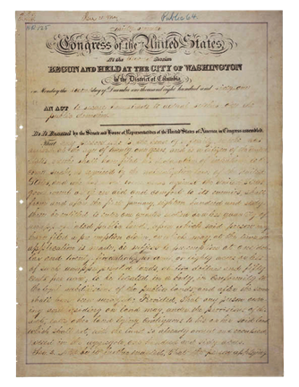
UC’s 1st Endowment ?
  History
  Who ?
  President Abraham Lincoln
What?
  150,000 Acres of land
  When?
  The Morrill Act – bill signed in 1862 to establish the countries land grant colleges and Universities.
  Current Market Value @ 2/29/2012 = $6.3 million
Notes:
Answer – Abraham Lincoln,
In 1862 when he signed the document pictured here. The Morrill Act – the bill signed in 1862 to establish the countries land grant colleges and Universities. The Morrill Act provided UC with 150,000 acres (30,000 acres for each legislator that California had at that time). The land, and proceeds from sale, were to establish an endowment (that can only be invested in a particular fashion). The Regents Federal Endowment Fund #05480. UC only recently sold off the last acreage obtained under the Morrill Act. In short, UC had an endowment BEFORE UC was established.
We are now at the 150th Anniversary of the Morrill Act – (the CA State Legislature even recently passed some sort of resolution calling on the federal government to “renew the commitment to accessible higher education and the support of research in the interest of the nation.”

Slide 9
  History
1st Real Major Gift to UC ?
  Who ?
  Regent Edward Tompkins
  What?
  47 acres of land in Oakland, California
  When?
  1872
  Agassiz Endowed Professorship in Oriental languages
  Current Market Value @ 2/29/2012 = $7.8 million.
Notes:
The Tompkins gift was 47 acres of land here in Oakland – the University was to sell some/all of the land until the University had $50,000 “in gold coin.” This would then be invested with the income supporting the salary of a professor.
This wasn’t reached until many years later, and the first Agassiz chair was appointed in 1895. The chair was assigned to Berkeley by the Board of Regents in 1933 (up until then, it was assumed that the University WAS Berkeley). In 1999 – when the Chair had a value of about $5.5 million – it was split into 4 Chairs (Chinese 500k ($569 k), Japanese 500k ($569 k) , Visiting Professor 1.0 m ($1.1 m), and 1872 Administrative Chair 3.5 m ($5.5 m).

Slide 10
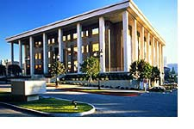
Largest True Endowments
Fund Name | Amount as of 2/29/2012
Jules Stein Eye Institute Permanent Endowment | $ 143.6 Million
Institute for Basic Research in Science Endowment | $ 86.7 Million
Elizabeth C. Proctor Medical Research Professorship | $ 36.0 Million
Senator William Andrews Clark Endowment | $ 26.4 Million
Thelma Hansen Endowment Fund | $ 23.9 Million
The Jules Stein Eye
Institute at UCLA

Slide 11
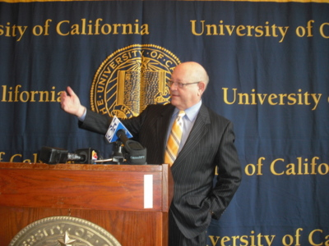
Largest FFE’s
Fund Name | Amount as of 2/29/2012
Presidents Endowment Fund | $ 429.7 Million
Searles Fund | $ 177.5 Million
R. D. & S. M. Robbins Law Library Fund | $ 89.0 Million
R.S. Springer Memorial Fund | $ 71.4 Million
Earl C Anthony Fund | $ 64.9 Million
The President’s Endowment Fund

Slide 12
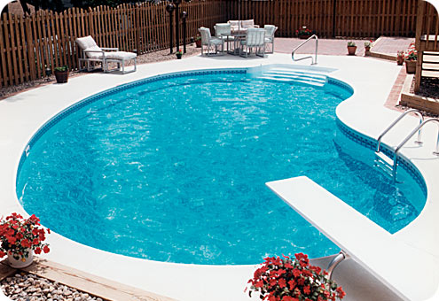
  What we do
  Investment Pools
    STIP (Short Term Income Pool): Established 1976 – investments are generally short term fixed or variable income securities.
        Market Value $10.01 billion
    TRIP (Total Return Income Pool): Established 2008 – investments are generally fixed or variable income and equity securities with longer terms.
        Market Value $3.74 billion
    GEP (General Endowment Pool): Established 1933, unitized 1958 - is The Regents’ primary investment vehicle for endowed gift funds. GEP is a balanced portfolio of equities, fixed-income securities, and alternative investments that provides diversification and economies of scale in the investment process to all participants.
        Market Value $6.65 billion
    UCRP (University of California Retirement Pool): Established 2007 – UCRP is a balanced portfolio of equities, fixed-income securities, and alternative investments that provides diversification and economies of scale in the investment process to all current and future retiree beneficiaries.
        Market Value $42.30 billion
*Market Values as of 2/29/2012

Slide 13
  What we do
  Investment Accounting
  Investment assets are the following:
Assets | UC | UCRS
Equity | 16% | 42%
Government guaranteed fixed income | 8% | 12%
Other U.S. fixed income | 52% | 17%
Commingle funds | 14% | 18%
Limited Partnerships | 5% | 10%
Others | 5% | 1%
@ 6/30/2011
Notes:
Account for UC’s portfolio of 56 Investments ($18 billion) and UCRS’s portfolio of 46 investments ($54 billion) @ Fiscal Year End (FYE)
Calculate each investment pool’s rate of return monthly and annually
Analyze investment holdings and prepare over 20 annual footnotes for the UC Annual Report.

Slide 14


  What we do
  Pool Processing
  Open new accounts.
  Transfer money to/from Campuses & other UC Affiliates.
  Reconcile the EIA Ledger to UC’s custodian bank (State Street).
  Calculate monthly share values.
  Allocate monthly pool income & process
  pool member purchases/sales.
  Process annual payouts.
Notes:
And funds
New fund setup
Monthly Investment Pool processing – STIP/TRIP/GEP/UCRP
Coordinate with the Office of General Council (OGC) and UC campuses/foundations/other affiliates to facilitate & process transfer funds to and from the EIA ledger
Process annual Endowment Payout & transfer to Campus
Prepare annual schedule & footnotes for the UC Annual Report

Slide 15
Central Bank-UC Strategic Investment Plan Loan processing
  What we do
In 2010, the CFO Division of the University of California, Office of the President (UCOP) established the UC Strategic Investment Program (UCSIP) as a suite of internal-loan financing programs that leverage the University's high credit rating to make low borrowing costs available for purposes beyond solely capital construction. UCSIP is a 3-pronged funding suite to address capital equipment acquisition, administrative efficiency projects, and faculty recruitment/retention
3 Internal-Loan Programs:
CapEquip (Capital Equipment)
C3 (Cross-Campus Collaboration)
STARs (Strategic Teaching Acquisition & Retention
Funding for non-campus include:
PPS Project
UCSHIP (UC Student Health Insurance Plan)
UCOE (UC Online Education)
http://www.ucop.edu/finance/ucsip.html
Notes:
Additional Information on this innovative program can be found on the CFO Division web site

Slide 16
  What we do
  Planned Giving Services (PGS)
  What is PGS?
    Planned Giving – gifts with a “string attached”
    Donors receive income during their lifetime
    Once deceased, gift fund transfers to designated UC purpose
  Why does a donor bother?
    Receive income and a charity deduction for partial gift value
    Payout to donor is 4%-6%
    Defer tax on sale of planned giving asset
  What we do?
        Coordinate each gift with the planned giving administrator
        (BNY Mellon) responsibilities.
    Annual tax and regulatory filings

Slide 17
  Moving Forward:
  EIA System Architecture Reengineering.
  In 2010, an effort was initiated to redesign the Endowment and Investment Accounting System (EIAS) application to provide for a more cost effective, higher quality solution using a combination of a hosted/cloud application service provider, a new Data Warehouse system and integration with a Financial G/L software package.
  We (EIA Team) are in the process of implementing a cloud vendor Fundriver in the current phase of reengineering.

Slide 18
Various Timelines
Historical time line of the UC Regents EIA ledger system & Pools
UCOP GLC, TIS & ENR migrated to UCOP Data Center
UCOP GLC, TIS migrated to EIAS GL & Pool Processing
UCB J TIS (pool Processing)
EIAS reporting & JE migrated to EIAOnline
University of California established
AMMA State college established
1st gift - Tompkins
Under reengineering
UCB J GLC
Paper ledger
Card entry
CAKES
EIA Journal entry
EIAOnline JE
1862 1868 1872 1933 1967 1974 1991 2001 2009 2010 2012
GEP established 1933 unitized 1958
STIP established 1976
HIP established 1987 ended 2010
UCRP established 2007
TRIP established 2008
http://www.berkeley.edu/about/hist/foundations.shtml
Notes:
1862 - Morrell Act Established the State Agricultural, Mining, and Mechanical Arts College funding but no campus
1868 – University of California established March 23, 1868, the state governor signed into law the Organic Act, "to Create and Organize the University of California by combining the State AM&MA college and the private College of California in Oakland – University of California opened in 1869 with 40 students
1872 - Thompkins gift
- UC Southern Campus
1949 – UCSF Designated
1952 – UC southern Campus renamed UCLA
1958 - Regents establish UC La Jolla which is renamed UCSD in 1960
1959 – UCD and UCR Designated as campuses
Cakes Corporate Accounting Key entry system

Slide 19

  Fiscal Year End (FYE) Closing Schedule :
There are appoximaly 102 closing steps for the EIA group.
Even though fiscal year ends on 6/30, we start preparing for the close starting in May of each year.
Our target is to close the fiscal year end along with Corporate Accounting group, campuses, and medical centers in Mid-September.
We publish our FYE schedule on our EIAOnline Website:
  https://eias.ucop.edu/eias/

Slide 20





  Fiscal Closing 2011-2012
  During fiscal year end these dogs are
  looking for their EIA owners & in need
  of attention!
  Arf. Woof. Woof. Bark. Awooo.

Slide 21
How Can We Help Each Other?
Completing EIA closing steps on time.
We are here to assist you, please assist us.
New Programs? Involve us early in the planning stage.
In need of Reports/Information, contact us early.
Notes:
New UCSHIP loans, STIP UCRP ARC loan
New Century Bond TRIP Investment.

Slide 22
Our Contact Information
  Kevin.Kendall@ucop.edu # 7-0919
  Anastasia.Lee@ucop.edu # 7-0923
  Kim.Williams@ucop.edu # 7-0922
  Helen.Zhu@ucop.edu # 7-0924
  Justin.Wong@ucop.edu # 7-0921
  Johhny.Wu@ucop.edu # 7-0926
  Suzanne.Cross@ucop.edu # 7-9843
Notes:
New UCSHIP loans, STIP UCRP ARC loan
New Century Bond TRIP Investment.

Slide 23
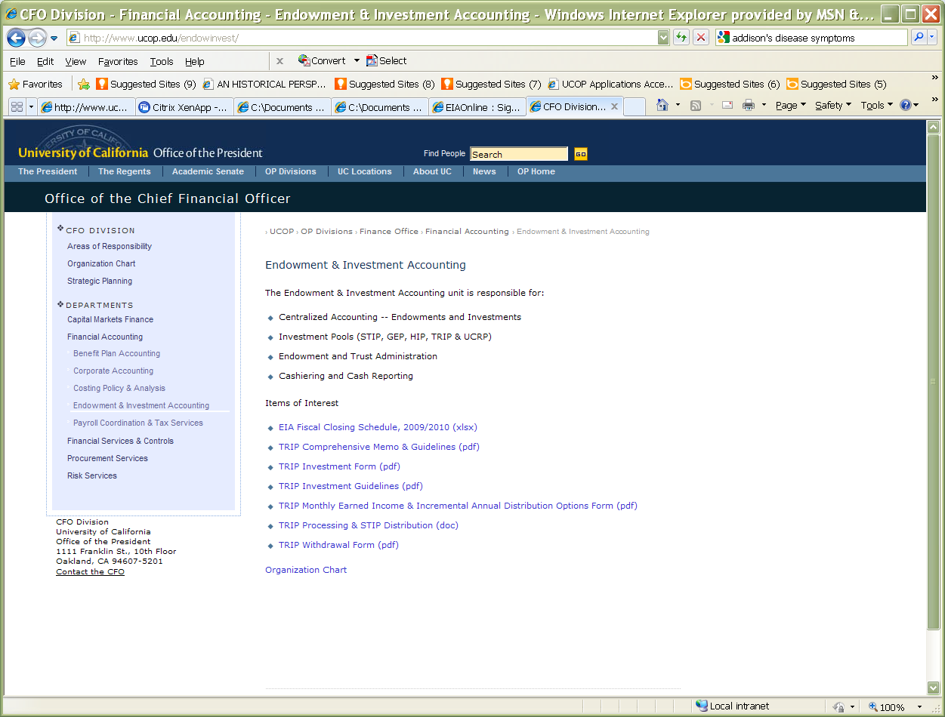
  CFO Division/Financial Accounting/Endowment & Investment : https://eias.ucop.edu/eias/

Slide 24
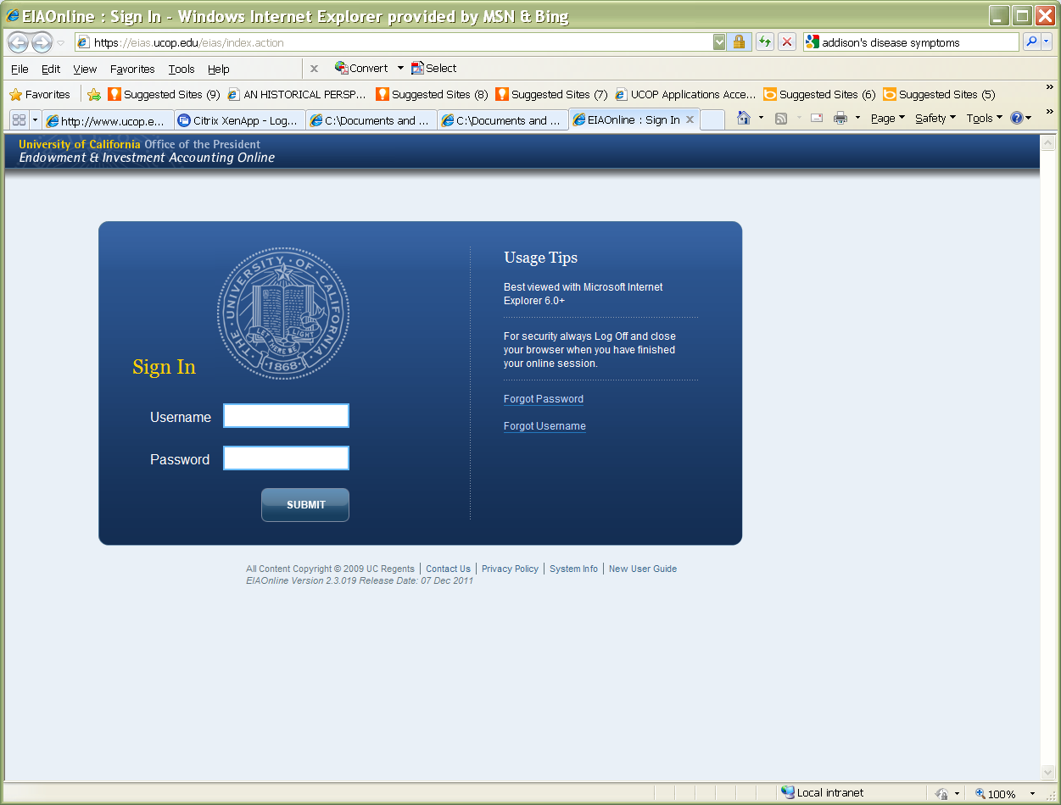
  EiaOnline: https://eias.ucop.edu/eias/index.action

Slide 25
Questions?
the end
March 29, 2012 Endowment & Investment Accounting

