Slide 1
2017 Open Enrollment

Slide 2
Pay Bands
The pay band thresholds are adjusted each year based on the Consumer Price Index (CPI) from the California Department of Finance based on the urban wage earners and clerical workers (CPI-U).
2016 | Definition of Range for Medical Contribution Base Using Full-Time Salary As of Jan. 2015
Pay Band
1 | $51,000 & Under
2 | $51,001 to $102,000
3 | $102,001 to $153,000
4 | $153,001 & Over
2017 | Definition of Range for Medical Contribution Base Using Full-Time Salary As of Jan. 2016
Pay Band
1 | $53,000 & Under
2 | $53,001 to $104,000
3 | $104,001 to $156,000
4 | $156,001 & Over

Slide 3
PPOs

Slide 4
PPO Administrator Changes
Medical – Anthem Blue Cross replaces Blue Shield for all PPOs. Health Equity continues as health savings account custodian for HSP
Behavioral Health – Anthem Blue Cross replaces Optum for UC Care, HSP and Core.
Prescription Drugs – OptumRx replaces Blue Shield for all PPOs

Slide 5
UC Health Savings Plan
Health Savings Account (HSA):
Individual Contribution Limit will increase from $3,350 to $3,400

Slide 6
Other
Health & Welfare Plans
Disability
Life
Accidental Death & Dismemberment (AD&D)
Legal

Slide 7
2017 Disability Plans
What’s changing:
Coverage eligibility will be expanded to Core and Mid-Level employees
Optional coverage will be called “Voluntary” rather than “Supplemental”
For optional coverage, employee will have choice to purchase:
Only Voluntary Short-term Disability (VSTD)
Only Voluntary Long-term Disability (VLTD)
Both VSTD and VLTD

Slide 8
2017 Disability Plans
What’s changing:
One 14-day waiting period rather than four
Disability benefit payments will decrease from 70% to 60%
VLTD will begin after 6 months rather than one year
More generous definitions of disability:
VSTD definition based on “own job”
VLTD determination based on “own occupation” for first two years, then “any occupation”

Slide 9
2017 Disability Plans
What won’t change:
UC will continue to provide a basic level of short-term coverage (Basic Disability)
Require use of 22 sick days, if available, before benefits commence
Notes:
If Karla didn’t address it – add that employees can use as much accrued sick leave as they want in order to continue to get full pay, prior to starting to receive disability insurance benefits

Slide 10
Life Insurance Plans
Employee Supplemental Life rates will decrease 7.4%
Dependent Basic and Expanded Life rates will decrease 7.5%
Not open for enrollment

Slide 11
AD&D Plan
Prudential will be the new carrier in 2017
No change to rates
Always open for enrollment
Notes:
Example of other minor change:
Currently the child tuition reimbursement is available if the child is enrolled in an institution of higher learning at time of employee’s death. New policy allows child to get benefit if they enroll within one year of employee’s death.
Add info re new benefits

Slide 12
Legal Plan
New benefits added – coverage for legal assistance related to:
Tax planning, preparation and audits
Administrative hearings (e.g., educational, building/zoning, Social Security/veterans/Medicare benefits)
Domestic violence protective orders
New live chat feature on website
3.9% rate increase
Open for enrollment
Notes:
Bring sheets describing the new benefits

Slide 13
Health Care FSA Reminder
The Health FSA maximum contribution amount is $2,550
You must re-enroll if you want to participate in 2017
You must contribute a minimum of $180 per year
If you enroll in the UC Health Savings Plan, you cannot enroll in the Health FSA

Slide 14
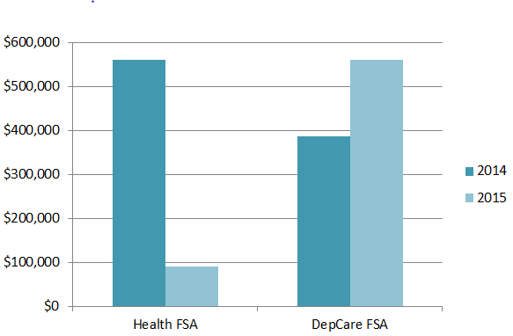
Health FSA - carryover reminder
You may carry over up to $500 of unused Health FSA funds into the next plan year
Carryover balance is determined after the April 15 run-out period (early May of the following plan year)
Unused funds greater than $500 are forfeited
FSA Forfeitures – $ lost

Slide 15
Health FSA: effective 2017 Plan Year
If you do not re-enroll in the Health FSA for 2017:
You must have a minimum of $25 in your account to be able to carry over remaining funds into the next plan year
Remaining funds under $25 are forfeited
Remaining funds will only be carried over for one plan year

Slide 16
Dependent Care FSA Reminder
Unlike Health FSA, no change to grace period extension (no carry-over feature)
Must re-enroll if you want to participate in 2017
Minimum contribution of $180 per year
Maximum contribution of $5,000 per year ($2,500 if married filing a separate tax return)
Last day to submit claims is April 15, 2017 for the 2016 plan year

Slide 17
Open Enrollment Events
Open Enrollment Workshops
November 1, 2016 / Noon – 1:00 p.m.
Winston Chung Hall / Rooms 205/206
November 7, 2016 / Noon – 1:00 p.m.
Human Resources Training Room, University Village, Suite 208
Benefits Fair
November 14, 2016 / 10:00 a.m. – 1:00 p.m.
HUB 302 North
Open Enrollment Walk-In Help Desk
November 21 & 22 / 8:00 a.m. – 5:00 p.m.
Human Resources Office, University Village, Suite 208

Slide 18
Benefits Office Contacts
Marsha Marion-Watson, Interim Benefits Manager
Tina Rodriguez, Benefits Lead
Veronica Luna, Health Care Facilitator
Alisha French, Senior Benefits Analyst
Office Hours / Contact
Monday – Friday / 8:00 a.m. – 5:00 p.m.
Phone: (951) 827-4766
Email: benefits@ucr.edu

